Slide 1
Module: Security
Upon completion of this module, you should be able to:
Describe key security terminologies
Describe key security threats in the cloud
Discuss key security mechanisms deployed in the cloud
Describe the role of GRC in the cloud
Notes:
This module focuses security cross-layer function of the cloud computing reference model. This module focuses on key security threats to a cloud infrastructure. It focuses on the various security mechanisms that enables the cloud service providers to mitigate these threats. Finally, this module focuses on the governance, risk, and compliance (GRC) aspect in a cloud environment.

Slide 2
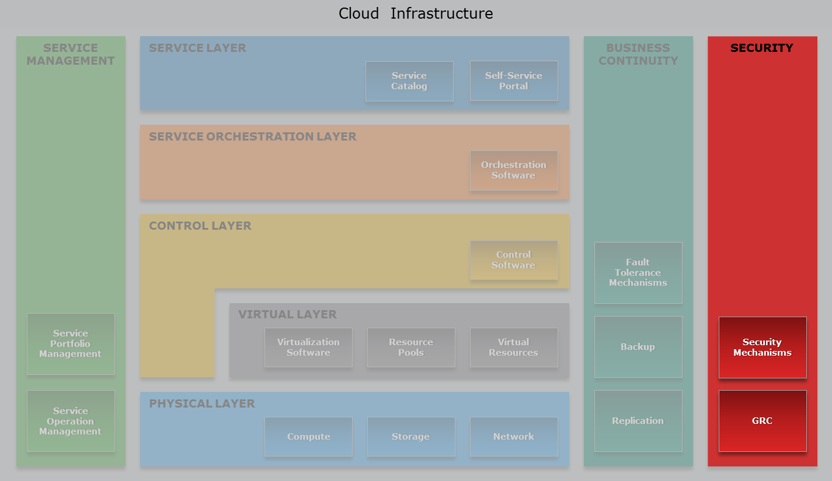
Cloud Computing Reference Model
Security Cross-layer Function
Notes:
Although, cloud computing offers several benefits, such as flexibility, scalability, and agility, security is one of the key factors that consumers are concerned about while adopting cloud. Therefore, it is important for a service provider to deploy the required security tools and mechanisms to offer a secure cloud environment to their consumers. The fundamental requirements of information security and compliance pertain to both non-cloud and cloud infrastructure management. In both the environments, there are some common security requirements. However, in a cloud environment there are important additional factors, which a service provider must consider, that arise from information ownership, responsibility and accountability for information security, and the cloud infrastructure’s multi-tenancy characteristic. Therefore, providing secure multi-tenancy is a key requirement for building a cloud infrastructure.
Apart from multi-tenancy, cloud infrastructure provides rapid elasticity, a feature rarely found in traditional data centers. Therefore, tools used to provide information security must have the ability to detect newly provisioned resources and integrate with these scaled resources to provide security. Without these capabilities, it is difficult to monitor and manage the security of such an environment.
The security mechanisms deployed in the cloud environment not only provide protection to the five layers (physical, virtual, control, service orchestration, and service layers), but it also provides protection to the two cross layer functions (service management and business continuity).
Apart from security mechanisms, service providers also require to adopt governance, risk and compliance (GRC) processes that enables the cloud provider to ensure that their acts are ethically correct and in accordance with their risk appetite (the risk level a service provider chooses to accept), internal policies, and external regulations. This also enables the service provider to meet the GRC requirement of their consumers.

Slide 3
Lesson: Introduction to Cloud Security
This lesson covers the following topic:
Key information security terminologies
Notes:
This lesson covers the key information security terminologies.

Slide 4
Drivers for Securing Cloud Infrastructure
Information is an organization’s most valuable asset
Various tools are deployed to protect the assets
Trust is one of the key concerns of consumers adopting cloud
Managing security has become increasingly important for cloud service providers
Trust = Visibility + Control
Notes:
Today, many organizations (consumers) run their applications in a cloud environment to take advantage of the capabilities discussed throughout this course. As organizations (consumers) adopt cloud, one of the key concerns they have is trust. Trust depends on the degree of control and visibility available to the information’s owner.
Information is an organization’s most valuable asset. Traditionally, organizations deploy various tools within their infrastructure to protect the asset. These tools must be deployed on various infrastructure assets, such as compute (processes information), storage (stores information), and network (carries information) to protect the information. In a cloud environment, security management enables cloud service providers to protect vital information of the consumers stored in the cloud. Managing the security of the infrastructure, which is an on-going effort that has become increasingly important for cloud service providers.

Slide 5
Information Security
Information Security
A term that includes a set of practices that protect information and information systems from unauthorized access, use, information disclosure, disruption, modification, or destruction.
— US Federal law (Title 38 Part IV, Chapter 57, Subchapter III USC 5727)
Goal of information security is to provide:
Confidentiality, integrity, and availability
Security mechanisms ensure right users have access to right resources at the right time
Auditing enables assessing effectiveness of the security mechanisms
Notes:
Information security is a term that includes a set of practices that protect information and information systems from unauthorized access, use, information disclosure, disruption, modification, or destruction.

Slide 6
Key Terminologies of Information Security
Confidentiality, Integrity, and Availability (CIA)
Authentication, Authorization, and Auditing (AAA)
Defense-in-depth
Trusted computing base
Secure multi-tenancy
Velocity of attack
Information assurance
Data privacy
Data ownership
Notes:
The slide lists the key information security terminologies, which are described in the next few slides.

Slide 7
Confidentiality, Integrity, and Availability
Confidentiality
Provides required secrecy of information
Ensures only authorized users have access to data
Integrity
Ensures unauthorized changes to data are not allowed
Availability
Ensures authorized users have reliable and timely access to resources
Notes:
The goal of information security is to provide Confidentiality, Integrity, and Availability, commonly referred to as the security triad, or CIA. Confidentiality provides the required secrecy of information to ensure that only authorized users have access to data. Integrity ensures that unauthorized changes to information are not allowed. The objective of ensuring integrity is to detect and protect against unauthorized alteration or deletion of information. Availability ensures that authorized users have reliable and timely access to compute, storage, network, application, and data resources.
Ensuring confidentiality, integrity, and availability are the primary objective of any IT security implementation. These are supported through the use of authentication, authorization, and auditing processes.

Slide 8
Authentication, Authorization, and Auditing
Authentication
Process to ensure users or assets are who they claim to be
Two methods: single-factor and multi-factor
Authorization
Process of determining access rights of a user, device, application, or process to a service or resource
Authorization should be performed only if authentication is successful
Auditing
Process to evaluate the effectiveness of security enforcement mechanisms
Notes:
Authentication is a process to ensure that users or assets are who they claim to be by verifying their identity credentials. A user may be authenticated by a single-factor or multi-factor method. Single-factor authentication involves the use of only one factor, such as a password. Multi-factor authentication uses more than one factor to authenticate a user (discussed later in this module).
Authorization refers to the process of determining whether and in what manner, a user, device, application, or process is allowed to access a particular service or resource. For example, a user with administrator’s privileges is authorized to access more services or resources compared to a user with non-administrator (for example, read-only) privileges. Authorization should be performed only if authentication is successful.
The most common authentication and authorization mechanisms, used in a data center and cloud environment are Windows Access Control List (ACL), UNIX permissions, Kerberos, and Challenge-Handshake Authentication Protocol (CHAP). It is essential to verify the effectiveness of security mechanisms that are deployed with the help of auditing.
Auditing refers to the logging of all transactions for the purpose of assessing the effectiveness of security mechanisms. It helps to validate the behavior of the infrastructure components, and to perform forensics, debugging, and monitoring activities.

Slide 9
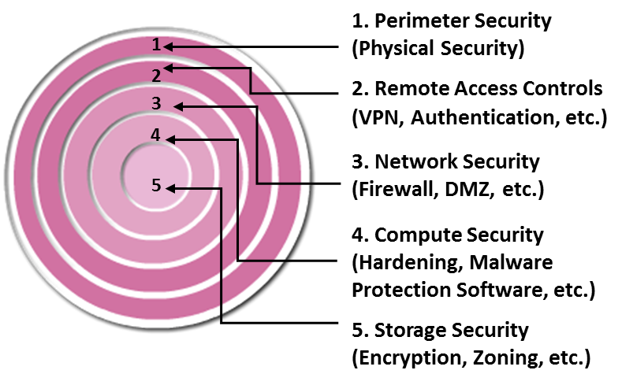
Defense-in-depth
Defense-in-depth
A strategy in which multiple layers of defense are deployed throughout the infrastructure to help mitigate the risk of security threats in case one layer of the defense is compromised.
Also known as a “layered approach” to security
Provides service providers additional time to detect and respond to an attack
Reduces the scope of a security breach
Notes:
A cloud service provider should deploy multiple layers of defense throughout the infrastructure to mitigate the risk of security threats, in case, one layer of the defense is compromised. This strategy is referred to as defense-in-depth. This strategy may also be thought of as a “layered approach to security” because there are multiple measures for security at different levels. Defense-in-depth increases the barrier to exploitation—an attacker must breach each layer of defenses to be successful—and thereby provides additional time to detect and respond to an attack. This potentially reduces the scope of a security breach. However, the overall cost of deploying defense-in-depth is often higher compared to single-layered security mechanisms. An example of defense-in-depth could be a virtual firewall installed on a hypervisor when there is already a network-based firewall deployed within the same environment. This reduces the chance of compromising the security of the hypervisor’s environment due to a successful breach of the network-level firewall.

Slide 10
Trusted Computing Base (TCB)
Trusted Computing Base
A set of all those components that are critical to the security of the cloud infrastructure.
Defines boundary for security-critical and non critical parts of a system
Vulnerabilities occurring inside TCB might jeopardize security of the entire system
Notes:
While developing a defense-in-depth strategy, the set of hardware and software components that are critical to the security of the cloud infrastructure—termed as trusted computing base (TCB)—must be considered. Vulnerabilities occurring inside the TCB might jeopardize the security of the entire system. TCB essentially defines a boundary for security-critical and non-critical parts of an information system. Understanding the security concerns and threats associated with the cloud environment, and a specific environment’s TCB requires an understanding of the relationships and dependencies between the cloud computing entities.

Slide 11
Secure Multi-tenancy
Requires mechanisms that prevent a tenant or its process from affecting another tenant’s information/process
Providers are responsible for ensuring secure multi-tenancy
Key focus areas | Description
Secure separation | Enables isolation of resources and services across consumers Example: At storage layer – separation of data at-rest and address space separation
Availability | Ensures that resources are accessible to all consumers by adhering to BC practices
Service assurance | Ensures that SLOs are met by dedicating runtime resources and QoS control
Management | Enables end-to-end infrastructure and service management for service providers Provides ability to delegate day-to-day management activities to the consumers
Notes:
As multi-tenancy enables multiple consumers to share the same set of resources, this consequently increases the concern about security risk to data confidentiality, integrity, and availability. This gives rise to a potential security concern about data leakage for the consumers because it makes their private data vulnerable to theft, manipulation, or destruction. Also, if a virtual machine in a multi-tenant environment is compromised, then it could increase the security risk to other virtual machines running on same compute systems. Secure multi-tenancy must be deployed to mitigate these concerns.
Secure multi-tenancy requires mechanisms that prevent any tenant from accessing another tenant’s information. It also requires mechanisms that prevent one tenant’s process from affecting another tenant’s process. Cloud service providers need to understand and address the security implications of multi-tenancy to ensure that the relevant security mechanisms are in place. Some examples of such security mechanisms are discussed later in this module are LUN masking, VLAN, and VSAN. Among the many issues to be handled when planning for security in a multi-tenant environment, four key areas must be considered: secure separation, availability, service assurance, and management.
Secure separation enables isolation of resources and services across various consumers in a multi-tenant environment. For example, at the storage layer, secure separation provides basic requirements such as separation of data at-rest (data that is stored on a storage device), address space separation, and separation of data access.
Availability ensures that resources are accessible to all consumers utilizing the provider’s infrastructure by adhering to business continuity practices as discussed in ‘Business Continuity’ module.
Service assurance provides service-level objectives (SLOs) that can be unique to each consumer. It ensures that SLOs are met at appropriate levels through the dedication of runtime resources and quality-of-service (QoS) control. The parameter of availability goes along with service assurance. While service assurance directs resources at the consumers’ level, availability secures resources at the providers’ level.
(Cont'd)

Slide 12
Secure Multi-tenancy
Requires mechanisms that prevent a tenant or its process from affecting another tenant’s information/process
Providers are responsible for ensuring secure multi-tenancy
Key focus areas | Description
Secure separation | Enables isolation of resources and services across consumers Example: At storage layer – separation of data at-rest and address space separation
Availability | Ensures that resources are accessible to all consumers by adhering to BC practices
Service assurance | Ensures that SLOs are met by dedicating runtime resources and QoS control
Management | Enables end-to-end infrastructure and service management for service providers Provides ability to delegate day-to-day management activities to the consumers
Notes:
Management enables coherent end-to-end infrastructure and service management for the service provider. It also provides the ability to delegate day-to-day management activities, such as resource provisioning and monitoring to consumers. Managing a multi-tenant environment requires mechanisms that enable consumers to control the operation and provisioning of resources allocated to them.
Providers are responsible for ensuring that mechanisms are in place to provide secure multi-tenancy, preventing unauthorized access to each consumer’s data. Today, many providers typically enforce uniform security controls and counter measures for all the tenants in a multi-tenant environment. In such an environment providers may disallow consumers from specifying contract clauses around security. The providers typically provide one set of controls, which is attested by a third party that all customers must accept.

Slide 13
Velocity-of-attack
Velocity-of-attack
Refers to a situation where an existing security threat in a cloud may spread rapidly and have large impact.
Factors amplifying threats and enable them spreading quickly:
Large number of infrastructure components
Homogeneity and standardization in platforms and components
Mitigation requires:
Strong and robust security enforcement
Containment mechanisms
Notes:
Velocity-of-attack refers to a situation where an existing security threat in a cloud may spread rapidly and have large impact. A cloud infrastructure typically has a large number of compute, storage, and network infrastructure components spanning geographic boundaries. The typical cloud environment also features homogeneity and standardization in the platforms and components, such as hypervisors, virtual machines file formats, and guest operating systems. These factors can amplify security threats and allow them to spread quickly. Mitigating velocity-of-attack is difficult in a cloud environment. Due to potentially high velocity-of-attack, providers must employ strong and robust security enforcement and containment mechanisms.

Slide 14
Information Assurance
Ensures CIA of consumers’ data in the cloud
Consumers need assurance that all the users:
Operating on the cloud do so legitimately
Accessing only those data for which they have rights
Accessing only to the degree their policies and their roles permit
Mitigation requires:
Strong authentication and authorization mechanisms to validate:
Consumers operating in cloud are genuine
Have right level of access to resources
Resilient cloud infrastructure
Notes:
Information assurance ensures confidentiality, integrity, and availability of consumers’ data in the cloud. In particular, cloud consumers need assurance that all the consumers operating on the cloud do so legitimately, accessing only data to which they have rights and only to the degree that policies and their roles permit. Although, information assurance is primarily a consumer’s concern, cloud providers should deploy strong authentication and authorization mechanisms to validate that all consumers operating in cloud are genuine and have right level of access to resources. Further, providers should build a resilient cloud infrastructure to ensure service availability, an infrastructure that has the ability to withstand certain types of failure and yet remain fully functional. Resilient cloud infrastructure is usually built by deploying business continuity.

Slide 15
Data Privacy
Legally protecting unauthorized disclosure of sensitive data of a consumer such as:
Personally identifiable information
Details of services requested by a consumer
Proprietary data of a consumer
Mitigation requires deploying mechanisms such as:
Data encryption (both data at-rest and in-transit)
Data shredding
Notes:
A provider needs to ensure that any sensitive data, which includes personally identifiable information (PII) about its consumers (or their customers or users), is legally protected from any unauthorized disclosure. Consumers must verify that providers should deploy robust mechanisms to ensure privacy of their data. Some of the mechanisms that can be deployed by providers to ensure data privacy that include encryption of data at-rest (data residing on a primary storage, backup media, or in the archives), data in-transit (data transmitted over cables), and data shredding.

Slide 16
Data Ownership
Two scenarios to determine ownership of data:
Service provider must ensure that consumers own their data
Scenarios | Description
Data created on-premise and then stored in the cloud | Data ownership remains with the creator based on factors such as: Contractual ownership Copyright law Trade secret Intellectual property
Data created in the cloud environment | Determination of who owns the data depends on: Terms of services (defined in service contract) Type of information Country in which it is generated and stored
Notes:
The ownership of data is influenced by factors such as copyright and contract, and may depend on the jurisdiction in which the data is created and stored. There are two basic scenarios. In the case of data that is created on-premise and then stored in the cloud, data ownership clearly remains with the creator based on various factors such as contractual ownership, data privacy, copyright law, trade secret, and intellectual property. However, when data is actually created in the cloud environment, the determination of who owns the data primarily depends on terms of services (defined in the service contract). There are other factors that may govern the ownership of data, such as the type of information and the country in which it is generated and stored. This can become even more complex if a provider has outsourced the infrastructure. In all cases, the cloud service provider must ensure that consumer always own the data. Further, there needs to be complete assurance that all regulated information and Intellectual Property (IP) generated by the consumer is solely owned by the consumer – whether it is created in the cloud or migrated there later. Cloud service provider also need to ensure that the contract specifies the country in which data will be stored and that ownership is still retained by consumers.

Slide 17
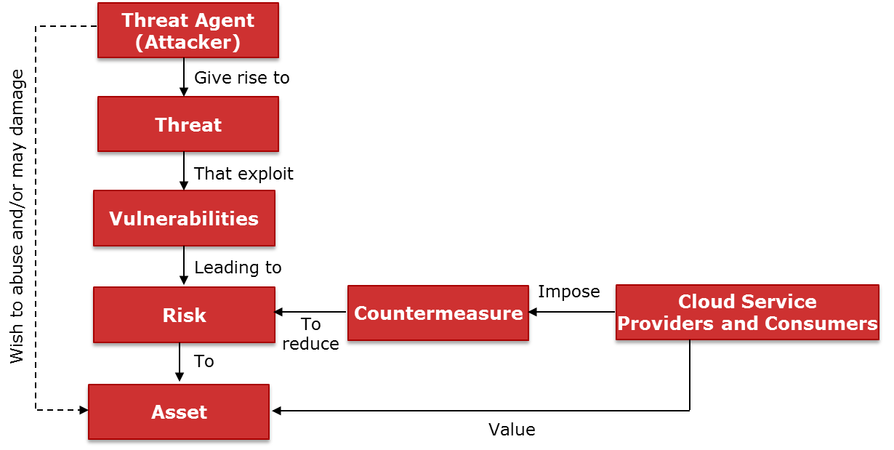
Security Concepts and Relationships
Notes:
The slide illustrates relationship among various security concepts in a cloud environment. Cloud service providers and consumers want to safeguard the asset from threat agents (attackers) who seek to abuse the assets. Risk arises when the likelihood of a threat agent (an attacker) to exploit the vulnerability arises. Therefore, the cloud service providers and consumers deploy various countermeasures to minimize risk by reducing the vulnerabilities.
Risk assessment is the first step to determine the extent of potential threats and risks in a cloud infrastructure. The process assesses risk and helps to identify appropriate controls to mitigate or eliminate risks. Cloud service providers must apply their normal information security and risk-management policies and standards to their cloud infrastructure, which is possible Some of the key security areas that cloud service providers must focus on while building the infrastructure are: authentication, identity and access management, data loss prevention and data breach notification, governance, risk, and compliance (GRC), privacy, network monitoring and analysis, security information and event logging, incident management, and security management. These security areas are covered later in this module.

Slide 18
Lesson Summary
During this lesson the following topics were covered:
Confidentiality, integrity, and availability
Authentication, authorization, and auditing
Defense-in-depth and trusted computing base
Multi-tenancy and velocity of attack
Information assurance
Data ownership and data privacy
Notes:
This lesson covered the key information security terminologies, such as confidentiality, integrity, availability, authentication, authorization, auditing, defense-in-depth, trusted computing base, multi-tenancy, velocity of attack, information assurance, and data ownership and privacy.

Slide 19
Lesson: Cloud Security Threats
This lesson covers the following topic:
Key threats in a cloud environment
Notes:
This lesson covers the key threats in a cloud environment.

Slide 20
Key Security Threats in a Cloud Environment
Key security threats according to CSA and ENISA
Data leakage
Data loss
Account hijacking
Insecure APIs
Malicious insiders
Denial of service
Abuse of cloud services
Shared technology vulnerabilities
Insufficient due diligence
Loss of governance and compliance
Notes:
According to the Cloud Security Alliance (CSA) and European Network and Information Security Agency (ENISA), the key threats in a cloud environment are: data leakage, data loss, account hijacking, insecure APIs, denial of service, malicious insiders, abuse of cloud services, insufficient due diligence, shared technology vulnerabilities, and loss of governance and compliance. Apart from describing these threats, this lesson also recommends various control mechanisms that a cloud service provider must consider while building cloud infrastructure to mitigate the threats.

Slide 21
Data Leakage
Occurs when an attacker gains access to a cloud consumer’s confidential data
Unauthorized access to confidential data may be gained by:
Compromising password database
Exploiting poor application design
Exploiting poor segregation of network traffic
Exploiting poor encryption implementation
Through a malicious insider
Control measure
Data encryption (both data at-rest and in-transit)
Data shredding and multi-factor authentication
Notes:
Data leakage occurs when an unauthorized entity (an attacker) gains access to a cloud consumer’s confidential data stored on the cloud infrastructure. An attacker may gain unauthorized access to consumers’ confidential data in a variety of ways, such as a compromised password database, poor application design, poor segregation of network traffic, poor encryption implementation, or through a malicious insider. Consider an example in which an attacker compromises the database that stores consumers’ passwords. It allows the attacker to impersonate a consumer or other legitimate user, thus exposing the consumer’s data. To mitigate the risk of such data leakage, providers may deploy a multi-factor authentication technique. When multi-factor authentication is used, a compromised password database will expose only a part of the authorization credential set, thus reducing the likelihood of a breach or attack.
Consider the example of cross-VM side channel attack to gain access to the consumer’s information. This attack is carried out in two steps: VM placement and information extraction.
In the VM placement step, a malicious VM is placed on a compute system on which the target virtual machine is running. One of the ways to accomplish that is by creating multiple virtual machines. Due to load balancing techniques employed by the hypervisor, new virtual machines may be placed on different compute systems. The attacker then probes each virtual machine created to identify its neighbors. The process is repeated until the target virtual machine is identified, allowing for the second step to be carried out.
(Cont'd)

Slide 22
Data Leakage
Occurs when an attacker gains access to a cloud consumer’s confidential data
Unauthorized access to confidential data may be gained by:
Compromising password database
Exploiting poor application design
Exploiting poor segregation of network traffic
Exploiting poor encryption implementation
Through a malicious insider
Control measure
Data encryption (both data at-rest and in-transit)
Data shredding and multi-factor authentication
Notes:
In the information extraction step, information about the target virtual machine is extracted by monitoring activity, such as keystrokes, cache data, and network traffic. This type of attack could reveal information related to a consumers’ critical business activity. The risks associated with this form of attack can be minimized by encrypting data, which reduces the exposure of confidential data of the consumers.
Additionally, an attacker may exploit multi-tenancy to gain visibility to the residual data or traces of operations of a consumer. This kind of attack may also provide access to consumer’s confidential information. Further, providers may also use data shredding capability to delete the residual data after a consumer has discontinued a cloud service. Encrypting and shredding data helps to prevent exposure of consumers’ confidential data to an attacker.

Slide 23
Data Loss
Occurs due to various reasons other than malicious attacks
Causes of data loss in the cloud include:
Accidental deletion by the provider
Destruction resulting from natural disasters
Providers are often responsible for data loss
Control measure
Data backup and replication
Notes:
Data loss can occur in the cloud due to various reasons other than malicious attacks. Some of the causes of data loss may include accidental deletion by the provider or destruction resulting from natural disasters. The provider is often responsible for data loss resulting from these causes and appropriate measures such as data backup can reduce the impact of such events. Providers must publish the protection mechanisms deployed to protect the data stored in cloud. Also, providers must ensure appropriate terms and conditions related to data loss and the associated penalties as part of the service contract. The service contract should also include various BC/DR options, such as backup and replication, offered to the consumers.

Slide 24
Account Hijacking
Occurs when an attacker gains access to consumers’ accounts
Controls measures: multi-factor authentication, IPSec, IDPS, and firewall
Types of attack | Description
Phishing | Social engineering attack used to deceive users Carried out by spoofing email containing link to a fake website Users credentials entered on the fake site are captured
Installing keystroke-logging malware | Attacker installs malware in a consumer’s VM Malware captures users credentials and sends to the attacker
Man-in-the-middle | Attacker eavesdrops on the network to capture credential
Notes:
Account hijacking refers to a scenario in which an attacker gains access to consumers’ accounts using methods such as phishing or installing keystroke-logging malware on consumers’ virtual machines.
Phishing is an example of a social engineering attack that is used to deceive users. Phishing attacks are typically carried out by spoofing email – an email with a fake but genuine-appearing address, which provides a link to a website that masquerades as a legitimate website. After opening the website, users are asked to enter details such as their login credentials. These details are then captured by the attacker to take over the user’s account. For example, a consumer may receive an email that is designed to appear as if the provider has sent it. This email may ask the consumer to click the link provided in the email and update their details. After clicking the email, the user is directed to a malicious website where their details are captured.
Another way to gain access to a user’s credentials is by installing keystroke-logging malware. In this attack, the attacker installs malware in the consumer’s virtual machine which captures user credentials and sends them to the attacker. After capturing the credentials, an attacker can use them to gain access to the consumer’s account. The attacker may then eavesdrop on the user’s activities and transactions, manipulate data, return falsified information, and redirect the clients to illegitimate sites. The attacker may also use the identity of the stolen account to launch subsequent attacks.
A “man-in-the-middle” attack is another way to hack users’ credentials. In this attack, the attacker eavesdrops—overhears the conversation—on the network channel between the consumer and the VM, and captures the credentials transmitted over the network. Use of multi-factor authentication and IPSec (a suite of algorithms, protocols, and procedures used for securing IP communications by authenticating and/or encrypting each packet in a data stream) can prevent this type of attack.
Intrusion detection and prevention systems and firewalls, which will be discussed later in this module are additional controls that may reduce the risk of such attacks.

Slide 25
Insecure APIs
APIs are used to perform activities such as:
Resource provisioning and configuration
Resource monitoring and management
Orchestration
APIs may be open or proprietary
Security of cloud services depends on security of APIs
Control measures
Design and develop APIs following security best practices
Perform security review of APIs
Access to APIs must be restricted to authorized users
Notes:
Application programming interfaces (APIs) are used extensively in cloud infrastructures to perform activities such as resource provisioning, configuration, monitoring, management, and orchestration. These APIs may be open or proprietary. The security of cloud services depends upon the security of these APIs. An attacker may exploit vulnerability in an API to breach a cloud infrastructure’s perimeter and carry out an attack. Therefore, APIs must be designed and developed following security best practices such as requiring authentication and authorization, and avoiding buffer overflows. Security review of the APIs must be performed by providers. Also, access to the APIs must be restricted to authorized users. These practices provide protection against both accidental and malicious attempts to bypass security.

Slide 26
Denial of Service (DoS) Attack
Prevents legitimate users from accessing resources or services
Could be targeted against compute systems, networks, or storage resources
Exhaust key resources, preventing production use by legitimate consumers
Example 1: Exhausting network bandwidth or CPU cycles
Example 2: Exploiting weaknesses in communication protocols
Example 3: Corrupting domain name server’s cache
Notes:
A Denial of Service (DoS) attack prevents legitimate users from accessing resources or services. DoS attacks can be targeted against compute systems, networks, or storage resources. In all cases, the intent of DoS is to exhaust key resources, such as network bandwidth or CPU cycles, thereby preventing production use. For example, an attacker may send massive quantities of data to the target with the intention of consuming bandwidth. This prevents legitimate consumers from using the bandwidth. Such an attack may also be carried out by exploiting weaknesses of a communications protocol. For example, an attacker may cause DoS to a legitimate consumer by resetting TCP sessions or corrupting the DNS server cache.
Consider another example of DoS attack specific to cloud environments where consumers are billed based on resource utilization. While conducting a network based DoS attack to prevent the consumer from using cloud services, the attacker can consume CPU cycles and storage capacity, resulting in non-productive expenses for the legitimate consumer. Apart from DoS attack, an attacker may also carry out Distributed DoS attack.

Slide 27
Distributed Denial of Service (DoS) Attack
DDoS is a variant of DoS attack
Several systems launch a coordinated DoS attack on target(s)
DDoS master program is installed on a compute system
Master program communicates to agents at designated time
Agents initiate the attack on receiving the command
Attacker is able to multiply the effectiveness of the DoS attack
Control measure
Impose restrictions and limits on resource consumption
Notes:
A Distributed DoS (DDoS) attack is a variant of DoS attack in which several systems launch a coordinated, simultaneous DoS attack on their target(s), thereby causing denial of service to the users of the targeted system(s). In a DDoS attack, the attacker is able to multiply the effectiveness of the DoS attack by harnessing the resources of multiple collaborating systems which serve as attack platforms. Typically, a DDoS master program is installed on one compute system. Then, at a designated time, the master program communicates to a number of "agent" programs installed on compute systems. When the agents receive the command, they initiate the attack.
The principal control mechanism that can minimize the impact of DoS and DDoS attack is to impose restrictions and limits on network resource consumption. For example, when it is identified that the amount of data being sent from a given IP address exceeds the configured limits, the traffic from that IP address may be blocked. This provides a first line of defense. Further, restrictions and limits may be imposed on resources consumed by each compute system, providing an additional line of defense.

Slide 28
Malicious Insiders
Malicious Insiders
An organization’s current or former employee, contractor, or other business partner who has or had authorized access to an organization's compute systems, network, or storage.
— Computer Emergency Response Team (CERT)
Intentional misuse of access to negatively impact CIA
Control measures:
Strict access control policies
Security audit and data encryption
Disable employee accounts immediately after separation
Segregation of duties (role-based access control)
Background investigation of candidates before hiring
Notes:
Today, most cloud service providers are aware of the security threats posed by outsiders. Countermeasures such as firewalls, malware protection software, and intrusion detection systems can minimize the risk of attacks from outsiders. However, these measures do not reduce the risk of attacks from malicious insiders. According to Computer Emergency Response Team (CERT), a malicious insider could be a organization’s (cloud service provider’s) current or former employee, contractor, or other business partner who has or had authorized access to a cloud service provider's compute systems, network, or storage. These malicious insiders may intentionally misuse that access in ways that negatively impact the confidentiality (data leakage), integrity, or availability of the cloud service provider’s information or resources.
For example, consider a former employee of a cloud service provider who had access to the cloud resources. This malicious insider may be aware of security weaknesses in that cloud infrastructure. This is a serious threat because the malicious insider may exploit the security weakness and can impact confidentiality, integrity, and availability. Control measures that can minimize the risk due to malicious insiders include strict access control policies, disabling employee accounts immediately after separation from the company, security audit, encryption, and segregation of duties (role-based access control, which is discussed later in this module). Also, a background investigation of a candidate before hiring is another key measure that can reduce the risk due to malicious insiders.

Slide 29
Abuse of Cloud Services
Cloud resources can be misused to perform unauthorized activities such as
Cracking an encryption key in minutes or hours
Distributing pirated software
Control measures
Difficult to mitigate merely with the help of tools
Establish agreement with consumers that have guidelines for acceptable use of cloud resources
Notes:
As discussed throughout this course, cloud computing offers several advantages to service providers and consumers. However, these cloud resources can be misused to perform unauthorized or illicit activities. For example, an attacker might require years to crack an encryption key using a personal compute system. However, the same key might be cracked in minutes or hours by using the extensive computing resources available from a cloud-based infrastructure. Alternately, an attacker may use cloud computing resources to perform illegal activities such as distributing pirated software. This could place providers and consumers in legal jeopardy. These types of threats are difficult to mitigate merely with the help of tools. However, service providers can establish an agreement with consumers that have guidelines for acceptable use of cloud resources.

Slide 30
Insufficient Due Diligence
Understanding the full scope of the undertaking while offering cloud services
Increase risks if services are offered without complete understanding of operational responsibilities such as:
Incident response
Encryption
Governance and compliance
Security monitoring
Notes:
Cloud service provider should pay due diligence towards understanding full scope of the undertaking while offering cloud services. For example, in a hybrid cloud environment, where cloud service provider connects to one or more cloud infrastructure(s) to leverage their capabilities, complete understanding of operational responsibilities is required. These responsibilities include incident response, encryption, governance, compliance, and security monitoring. Insufficient due diligence towards understanding these responsibilities may increase risk levels.
Similarly, understanding operational responsibilities are essential when a service provider may act as a broker by connecting to multiple cloud service providers to integrate their capabilities and offer services to the consumers. For example, if a cloud service broker offers services using resources from multiple cloud service providers that do not meet the security requirements of the consumers may expose consumers’ data to increased risk. This risk can be minimized by thoroughly understanding and evaluating the cloud providers’ services and their terms, ensuring that they provide security controls that can meet the consumer’s security requirements. Further, it is important to understand the consumers’ risk profile to ensure that the risks involved are within acceptable levels.

Slide 31
Shared Technology Vulnerabilities
An attacker may exploit the vulnerabilities of tools used to enable multi-tenant environments
Examples of threats:
Failure of mechanisms that provide separation of memory and storage
Hyperjacking attack involves installing a rogue hypervisor that takes control of compute system
Control measure
Securing components that are part of trusted computing base
Notes:
Technologies that are used to build a cloud infrastructure provide a multi-tenant environment enabling the sharing of resources. Multi-tenancy is achieved by using mechanisms that provide separation of computing resources such as memory and storage for each consumer. Failure of these mechanisms may expose consumer’s data to other consumers, raising security risks. Compromising a hypervisor is a serious event because it exposes the entire environment to potential attacks. Hyperjacking is an example of this type of attack in which the attacker installs a rogue hypervisor that takes control of the compute system. The attacker now can use this hypervisor to run unauthorized virtual machines in the cloud and carry out further attacks. Detecting this attack is difficult and involves examining components such as program memory and the processor core registers for anomalies. It may be possible to prevent hyperjacking by securing components that are part of the trusted computing base.

Slide 32
Loss of Compliance
Loss of Compliance
Occur when a cloud service provider or cloud broker does not adhere to, and demonstrating adherence to external laws and regulations as well as corporate policies and procedures.
Regulations mandate vulnerability assessment when using certain type of data
Aimed at discovering potential security vulnerabilities
Example: PCI compliance for handling credit card data
Participating cloud provider may prohibit through contract terms
Cloud brokers and consumers have to rely on provider’s vulnerability assessment results
Notes:
Loss of compliance may occur when a cloud service provider or cloud broker does not adhere to, and demonstrating adherence to, external laws and regulations as well as corporate policies and procedures.
For example, there are regulations that mandate businesses to perform vulnerability assessment when dealing with certain types of data. Vulnerability assessment is aimed at discovering potential security vulnerabilities in the environment by “scanning” the compute, storage, and network resources. Payment Card Industry (PCI) compliance is an example that governs the guidelines for handling credit card data. A cloud broker offers services using resources from multiple cloud service providers may not allow a consumer to perform vulnerability assessment. This is because performing vulnerability assessment may be prohibited by the cloud providers, participating in the broker service, through their contract terms, since any scan employed has the potential to disrupt services to other consumers. In such a scenario, the cloud broker and consumers have to rely on the results of the vulnerability assessment performed by the cloud service providers.

Slide 33
Loss of Governance
Causes of loss of governance:
Provider outsource its services to third-parties
Impact of outsourcing services to third-parties:
No control over third-parties, and may impact commitments of the provider
Security controls of provider may change impacting terms and conditions of provider
Provider may not be able to supply evidence of meeting their providers’ compliance requirements
Notes:
The effectiveness of governance processes (which determines the purpose, strategy and operational rules by which companies are directed and managed) may be diminished when the cloud provider outsources some or all of its services to third-parties, including cloud brokers. In such a scenario, provider may not have control over many aspect that have been outsourced and therefore may impact the commitments given by the provider. Also, the security controls of the third-party may change, which may impact the terms and conditions of the provider. Further, if a third party is unable to supply the evidence of meeting the providers' compliance requirements, this may put the provider at risk.
To better prepare for the threats discussed in this lesson, cloud service providers deploy various security mechanisms. These security mechanisms are discussed in the following lessons.

Slide 34
Lesson Summary
During this lesson the following topics were covered:
Data leakage and data loss
Account hijacking and insecure APIs
Malicious insiders and denial of service
Abuse of cloud services and shared technology vulnerabilities
Insufficient due diligence
Loss of compliance and governance
Notes:
This lesson covered key security threats in a cloud environment. These threats are data leakage, data loss, account hijacking, insecure APIs, malicious insiders, denial of service, abuse of cloud services, shared technology vulnerabilities, insufficient due diligence, loss of compliance, and loss of governance.

Slide 35
Lesson: Security Mechanisms – I
This lesson covers the following topics:
Physical security
Identity and access management
Notes:
This lesson covers physical security and identity and access management deployed in cloud environment.

Slide 36
Introduction to Security Mechanisms
Security mechanisms can be classified as:
Technical security mechanisms must be deployed at:
Compute level
Network level
Storage level
Mechanisms | Description
Administrative | Security and personnel policies or standard procedures to direct the safe execution of various operations
Technical | Usually implemented through tools or devices deployed on computer systems, networks, or storage
Notes:
Any security mechanism should account for three aspects: people, process, and technology, and the relationships among them. Security mechanisms can be administrative or technical. Administrative mechanisms include security and personnel policies or standard procedures to direct the safe execution of various operations. Technical mechanisms are usually implemented through tools or devices deployed on the IT infrastructure.
To protect cloud infrastructure, various technical security mechanisms must be deployed at the compute, network, and storage levels.

Slide 37
Key Security Mechanisms
Physical security
Identity and access management
Role-based access control
Network monitoring and analysis
Firewall
Intrusion detection and prevention system
Adaptive security
Port binding and fabric binding
Virtual private network
Virtual LAN and virtual SAN
Zoning and iSNS discovery domain
Security hypervisor and management server
Virtual machine hardening
Securing operating system and applications
LUN masking
Data encryption
Data shredding
Notes:
At the compute system level, security mechanisms are deployed to secure hypervisors and hypervisor management systems, virtual machines, guest operating systems and applications. Security at the network level commonly includes firewalls, demilitarized zones, intrusion detection systems, virtual private networks, zoning and iSNS discovery domains, port binding and fabric binding configurations, and VLAN and VSAN. At the storage level, security mechanisms include LUN masking, data shredding, and data encryption. Apart from these security controls, cloud also requires identity and access management, role based access control, and physical security arrangements.

Slide 38
Physical Security
Foundation of overall IT security strategy
Some of the measures to secure cloud infrastructure are:
Disabling all unused devices and ports
24/7/365 onsite security
Biometric or security badge-based authentication to grant access to the facilities
Surveillance cameras to monitor activity throughout the facility
Sensors and alarms to detect motion and fire
Notes:
Physical security is the foundation of any overall IT security strategy. Strict enforcement of policies, processes, and procedures by cloud service providers are critical elements of successful physical security. To secure the cloud infrastructure, the following physical security measures may be deployed:
Disable all unused IT infrastructure devices and ports
24/7/365 onsite security
Biometric or security badge-based authentication to grant access to the facilities
Surveillance cameras [CCTV] to monitor activity throughout the facility
Sensors and alarms to detect motion and fire

Slide 39
Identity and Access Management
Identity and Access Management
A process of managing consumers’ identifiers, and their authentication and authorization to access cloud resources.
Cloud providers deploy both traditional and new authentication and authorization mechanisms
Mechanisms | Description | Examples
Authorization | Restricts accessibility and sharing of files and folders | Windows ACLs, UNIX permissions, and OAuth
Authentication | Enables authentication among client and server | Multi-factor authentication, Kerberos, CHAP, and OpenID
Notes:
Identity and access management is the process of managing consumers’ identifiers and their authentication and authorization to access cloud resources. It also controls access to resources by placing restrictions based on consumer identities. In today’s cloud environment, an organization may collaborate with multiple cloud service providers to access various cloud-based applications. This requires deploying multiple authentication systems to enable the organization to authenticate employees and provide access to cloud-based applications.
The cloud environment uses both traditional and new authentication and authorization mechanisms to provide identity and access management. The key traditional authentication and authorization mechanisms deployed in an environment are Windows ACLs, UNIX permissions, Kerberos, and Challenge-Handshake Authentication Protocol (CHAP). Alternatively, the organization can use Federated Identity Management (FIM) for authentication. A federation is an association of organizations and cloud service providers (referred to as trusted parties) that come together to exchange information about their users and resources to enable collaboration. Federation includes the process of managing the trust relationships among the trusted parties beyond internal networks or administrative boundaries. FIM enables the service providers to offer services without implementing their own authentication system. The organization can choose an identity provider to authenticate their users. This involves exchanging identity attributes between the cloud service provider and the identity provider in a secure way. New identity and access management mechanisms used in cloud include OpenID and OAuth.

Slide 40
Windows ACL and UNIX Permission
Windows ACL
UNIX Permission
Types of ACLs:
DACL: determine access control
SACL: determine what accesses needs to be audited
Support object ownership in addition to ACLs
Child objects inherit ACL of parent object
Use SID to control object access
SIDs uniquely identify a user or a user group
Common permissions: Read/Write/Execute
Specify operations by ownership relation with respect to a file:
What the owner can do?
What the owner group can do?
What everyone else can do?
Notes:
Windows ACLs and UNIX Permissions form the first level of protection to compute resources (application servers, file servers, and file sharing environment such as NAS) by restricting accessibility and sharing. These permissions are deployed over and above the default behaviors and attributes associated with files and folders. In addition, various other authentication and authorization mechanisms, such as Kerberos and directory services are implemented to verify the identity of network users and define their privileges.
Windows supports two types of ACLs: discretionary access control lists (DACLs) and system access control lists (SACLs). The DACL, commonly referred to as the ACL, is used to determine access control. The SACL determines what accesses need to be audited if auditing is enabled. In addition to these ACLs, Windows also supports the concept of object ownership. The owner of an object has hard-coded rights to that object, and these rights do not need to be explicitly granted in the SACL. The owner, SACL, and DACL are all statically held as attributes of each object. Windows also offers the functionality to inherit permissions, which allows the child objects existing within a parent object to automatically inherit the ACLs of the parent object. ACLs are also applied to directory objects known as security identifiers (SIDs). These are automatically generated by a Windows server or domain when a user or group is created, and they are abstracted from the user. In this way, though a user may identify his login ID as “User1,” it is simply a textual representation of the true SID, which is used by the underlying operating system. Internal processes in Windows refer to an account’s SID rather than the account’s username or group name while granting access to an object. ACLs are set by using the standard Windows Explorer GUI but can also be configured with CLI commands or other third-party tools.
(Cont'd)

Slide 41
Windows ACL and UNIX Permission
Windows ACL
UNIX Permission
Types of ACLs:
DACL: determine access control
SACL: determine what accesses needs to be audited
Support object ownership in addition to ACLs
Child objects inherit ACL of parent object
Use SID to control object access
SIDs uniquely identify a user or a user group
Common permissions: Read/Write/Execute
Specify operations by ownership relation with respect to a file:
What the owner can do?
What the owner group can do?
What everyone else can do?
Notes:
For the UNIX operating system, a user is an abstraction that denotes a logical entity for assignment of ownership and operation privileges for the system. A user can be either a person or a system operation. A UNIX system is only aware of the privileges of the user to perform specific operations on the system and identifies each user by a user ID (UID) and a username, regardless of whether it is a person, a system operation, or a device. In UNIX, users can be organized into one or more groups. The concept of group serves the purpose of assigning sets of privileges for a given resource and sharing them among many users that need them. For example, a group of people working on one project may need the same permissions for a set of files. UNIX permissions specify the operations that can be performed by any ownership relation with respect to a file. In simpler terms, these permissions specify what the owner can do, what the owner group can do, and what everyone else can do with the file.
Consider an example of a file-sharing environment, in which NAS devices use standard file-sharing protocols such as NFS and CIFS. Authentication and authorization are implemented and supported on NAS devices in the same way as in a UNIX or Windows file sharing environment. Authentication requires verifying the identity of a network user and involves a login credential lookup on a Network Information System (NIS) server in a UNIX environment. Similarly, a Windows client is authenticated by a Windows domain controller that houses the Active Directory. The Active Directory uses a construct called Lightweight Directory Access Protocol (LDAP) to access information about network objects in the directory and Kerberos for network security. NAS devices use the same authentication techniques to validate network user credentials.

Slide 42
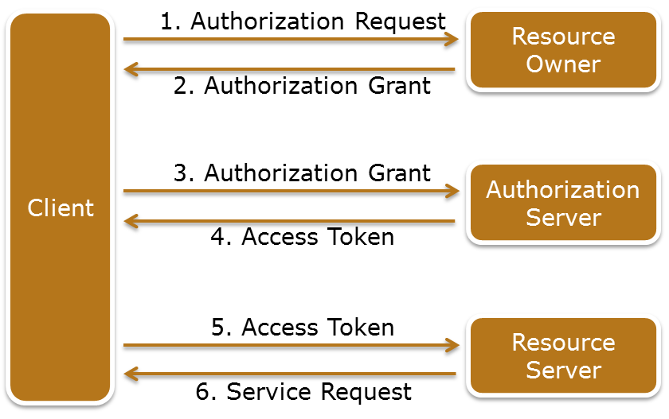
OAuth
OAuth
An open authorization mechanism allows a client to access protected resources from a resource server on behalf of a resource owner.
Entities involved in authorization:
Resource owner
Resource server
Client
Authorization server
Notes:
OAuth is an open authorization mechanism that allows a client to access protected resources from a resource server on behalf of a resource owner. There are four entities involved in the authorization mechanism: resource owner, resource server, client, and authorization server. A resource owner is an entity capable of granting access to a protected resource. A resource server is the compute system hosting the protected resources, capable of accepting and responding to protected resource requests using access tokens. A client is an application making protected resource requests on behalf of the resource owner with the resource owner’s authorization. An authorization server is the compute system issuing access tokens to the client after successfully authenticating the resource owner and obtaining authorization. The authorization server may be the same server as the resource server or a separate entity.
The figure on the slide illustrates the steps involved in OAuth process as described in Request for Comments (RFC) 6749 published by Internet Engineering Task Force (IETF):
The client requests authorization from the resource owner. The authorization request can be made directly to the resource owner, or indirectly via the authorization server.
The client receives an authorization grant, which is a credential representing the resource owner's authorization to access its protected resources. It is used by the client to obtain an access token. Access tokens are credentials used to access protected resources. An access token is a string representing an authorization issued to the client. The string is usually opaque to the client. Tokens represent specific scopes and durations of access, granted by the resource owner, and enforced by the resource server and authorization server.
The client requests an access token by authenticating with the authorization server and presenting the authorization grant.
(Cont'd)

Slide 43
OAuth
OAuth
An open authorization mechanism allows a client to access protected resources from a resource server on behalf of a resource owner.
Entities involved in authorization:
Resource owner
Resource server
Client
Authorization server
Notes:
The authorization server authenticates the client and validates the authorization grant, and if valid, issues an access token.
The client requests the protected resource from the resource server and authenticates by presenting the access token.
The resource server validates the access token, and if valid, serves the request.

Slide 44
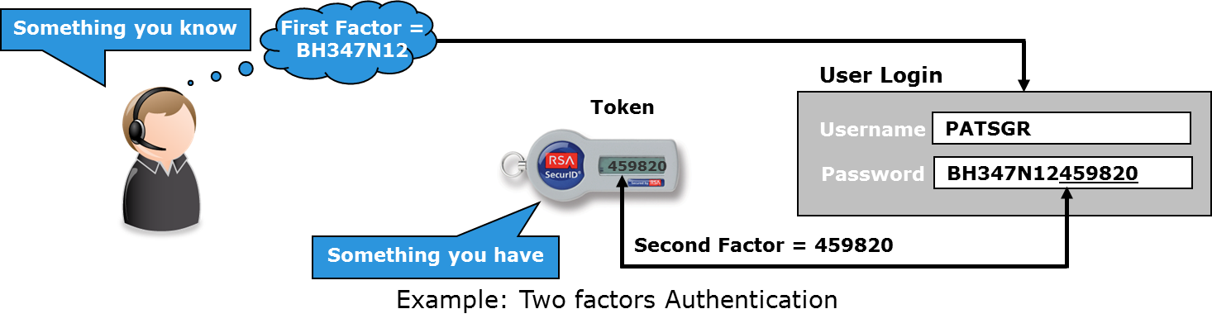
Multi-factor Authentication
Multiple factors for authentication:
First factor: What a user knows? For example, a password
Second factor: What the user has? For example, a token
Third factor: Who is the user? or What the user did? For example, a unique ID or user’s past activity
Access is granted only when all the factors are validated
Notes:
Multi-factor authentication uses more than one factor to authenticate a user. A commonly implemented two-factor authentication process requires the user to supply both something he or she knows (such as a password) and also something he or she has (such as a device). The second factor might also be a password generated by a physical device (known as token), which is in the user’s possession. The password generated by the token is valid for a pre-defined time. The token generates another password after the pre-defined time is over. To further enhance the authentication process, additional factors may also be considered. Examples of additional factors that may be used include unique ID number, and user’s past activity. A multi-factor authentication technique may be deployed using any combination of these factors. A user’s access to the environment is granted only when all the required factors are validated.

Slide 45
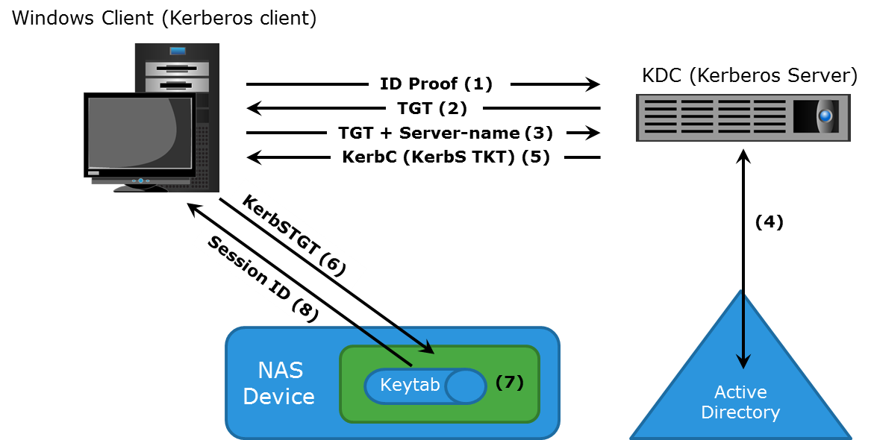
Kerberos
Kerberos
A network authentication protocol, which provides strong authentication for client/server applications by using secret-key cryptography. A client and server can prove their identity to each other across an insecure network connection.
Notes:
Kerberos is a network authentication protocol, which is designed to provide strong authentication for client/server applications by using secret-key cryptography. It uses cryptography so that a client and server can prove their identity to each other across an insecure network connection. After the client and server have proven their identities, they can choose to encrypt all their communications to ensure privacy and data integrity. In Kerberos, authentications occur between clients and servers. The client gets a ticket for a service and the server decrypts this ticket by using its secret key. Any entity, user, or compute system that gets a service ticket for a Kerberos service is called a Kerberos client. The term Kerberos server generally refers to the Key Distribution Center (KDC). The KDC implements the Authentication Service (AS) and the Ticket Granting Service (TGS). In Kerberos, users and servers for which a secret key is stored in the KDC database are known as principals. The KDC has a copy of every password associated with every principal, so it is absolutely vital that the KDC remain secure.
(Cont'd)

Slide 46
Kerberos
Kerberos
A network authentication protocol, which provides strong authentication for client/server applications by using secret-key cryptography. A client and server can prove their identity to each other across an insecure network connection.
Notes:
Consider an example of NAS environment in which Kerberos is primarily used when authenticating against a Microsoft Active Directory domain, although it can be used to execute security functions in UNIX environments.
The Kerberos authorization process includes the following steps:
The user logs on to the workstation in the AD domain using an ID and a password. The client computer sends a request to the AS running on the KDC for a Kerberos ticket. The KDC verifies the user’s login information from AD (step not shown in the figure).
The KDC responds with an encrypted Ticket Granting Ticket (TGT) and an encrypted session key. TGT has a limited validity period. TGT can be decrypted only by the KDC, and the client can decrypt only the session key.
When the client requests a service from a server, it sends a request, consisting of the previously generated TGT, encrypted with the session key and the resource information to the KDC.
The KDC checks the permissions in AD and ensures that the user is authorized to use that service.
The KDC returns a service ticket to the client. This service ticket contains fields addressed to the client and to the server hosting the service.
The client then sends the service ticket to the server that houses the required resources.
The server, in this case the NAS device, decrypts the server portion of the ticket and stores the information in a keytab file. As long as the client’s Kerberos ticket is valid, this authorization process does not need to be repeated. The server automatically allows the client to access the appropriate resources.
A client/server session is now established. The server returns a session ID to the client, which is used to track the client activity as long as the session is active.

Slide 47
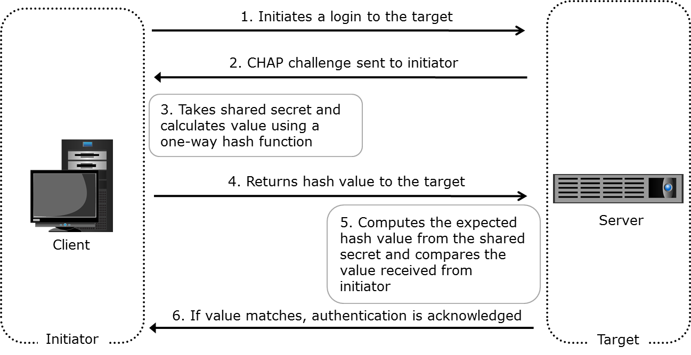
Challenge Handshake Authentication Protocol
Provides a method for initiators and targets to authenticate each other by utilizing a secret code
Notes:
The Challenge-Handshake Authentication Protocol (CHAP) is a basic authentication mechanism that has been widely adopted by network devices and compute systems. CHAP provides a method for initiators and targets to authenticate each other by utilizing a secret code or password. CHAP secrets are usually random secrets of 12 to 128 characters. The secret is never exchanged directly over the communication channel; rather, a one-way hash function converts it into a hash value, which is then exchanged. A hash function, using the MD5 algorithm, transforms data in such a way that the result is unique and cannot be changed back to its original form.
If the initiator requires reverse CHAP authentication, the initiator authenticates the target by using the same procedure. The CHAP secret must be configured on the initiator and the target. A CHAP entry, composed of the name of a node and the secret associated with the node, is maintained by the target and the initiator. The same steps are executed in a two-way CHAP authentication scenario.
After these steps are completed, the initiator authenticates the target. If both authentication steps succeed, then data access is allowed. CHAP is often used because it is a fairly simple protocol to implement and can be implemented across a number of disparate systems.

Slide 48
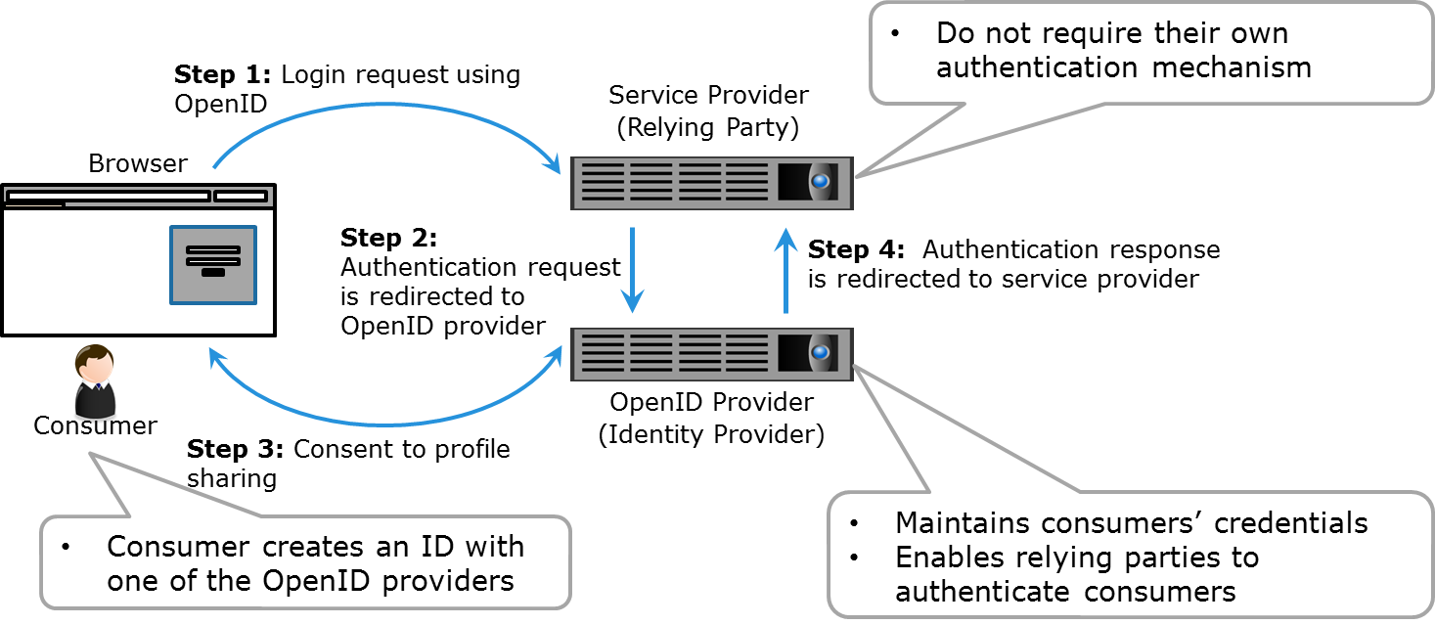
OpenID
OpenID
An open standard for authentication in which a service provider uses authentication services from an OpenID provider.
Notes:
OpenID is an open standard for authentication in which a service provider (known as the relying party) uses authentication services from an OpenID provider (known as the identity provider). An OpenID provider maintains consumers’ credentials on their authentication system and enables relying parties to authenticate consumers requesting the use of the relying party’s services (in this case, a cloud-based service). This eliminates the need for the relying party to deploy their own authentication systems. In the OpenID mechanism, a consumer creates an ID with one of the OpenID providers. This OpenID then can be used to sign-on to any provider (relying party) that accepts Open ID authentication.
The figure on the slide illustrates the OpenID concept by considering a consumer who requires services from the relying party. For the consumer to use the services provided by the relying party an identity (user ID and password) is required. The relying party does not provide their own authentication mechanism, however they support OpenID from one or more OpenID providers. The consumer can create an ID with the identity provider and then uses this ID with the relying party. The relying party, after receiving the login request, authenticates it with the help of identity provider and then grants access to the services.

Slide 49
Lesson Summary
During this lesson the following topics were covered:
Physical security
Windows ACLs and UNIX permissions
OAuth
Multi-factor authentication
Kerberos and CHAP
OpenID
Notes:
This lesson covered physical security, Windows ACLs, UNIX permissions, Oauth, multi-factor authentication, Kerberos, CHAP, and OpenID.

Slide 50
Lesson: Security Mechanisms – II
This lesson covers the following topics:
Role-based access control
Network monitoring and analysis
Firewall and intrusion detection and prevention system
Adaptive security
VPN, VLAN, VSAN, zoning and iSNS discovery domain
Port binding and fabric binding
Notes:
This lesson covers role-based access control, network monitoring and analysis, firewall, intrusion detection and prevention system, adaptive security, port binding and fabric binding, virtual private network, virtual LAN, virtual SAN, zoning, and iSNS discovery domain mechanisms deployed in a cloud environment.

Slide 51
Key Security Mechanisms
Physical security
Identity and access management
Role-based access control
Network monitoring and analysis
Firewall
Intrusion detection and prevention system
Adaptive security
Virtual private network
Virtual LAN and virtual SAN
Zoning and iSNS discovery domain
Port binding and fabric binding
Security hypervisor and management server
Virtual machine hardening
Securing operating system and applications
LUN masking
Data encryption
Data shredding

Slide 52
Role-based Access Control
An approach to restrict access to authorized users based on their respective roles
Only those privileges are assigned to a role that are required to perform tasks associated with that role
Separation of duties ensure that no single individual can both specify an action and carry it out
Notes:
Role-based access control (RBAC) is an approach to restricting access to authorized users based on their respective roles. A role may represent a job function, for example, a storage administrator. The only privileges assigned to the role are those required to perform the tasks associated with that role.
It is advisable to consider administrative controls, such as separation of duties, when defining data center security procedures. Clear separation of duties ensures that no single individual can both specify an action and carry it out. For example, the person who authorizes the creation of administrative accounts should not be the person who uses those accounts.

Slide 53
Network Monitoring and Analysis
A proactive measure to detect and prevent network failure or performance problems
Network monitoring can be performed in two ways:
Mechanisms used to monitor, detect, and prevent attacks are:
Firewalls, IDPS and network analysis/forensics systems
Monitoring | Description
Active | Monitoring tools transmit data between two endpoints that are monitored
Passive | Information about a link or device is collected by probing the link or device
Notes:
Monitoring and analyzing the network are important for the smooth and continuous operation of a cloud infrastructure. Network availability can be compromised by DoS attacks and network device failures. Proactive network monitoring and analysis can detect and prevent network failures or performance problems.
Network monitoring can be performed in two ways: active monitoring and passive monitoring. In active monitoring, the monitoring tools transmit data between the two endpoints that are monitored. The measurement includes parameters such as availability, delay, loss, and bandwidth. In passive monitoring, instead of transmitting data and then measuring, information about a link or device is collected by probing the link or device. As the data passes through the link or device, information is captured. This information is then used to analyze, detect, and troubleshoot any issues related to performance, availability, or security. Some of the mechanisms used to monitor, detect, and prevent attacks are firewalls, intrusion detection systems, intrusion prevention systems, and network analysis/forensics systems.

Slide 54
Firewall
Firewall
A security mechanism designed to examine data packets traversing a network and compare them to a set of filtering rules.
Can be deployed at:
Network level
Compute level
Hypervisor level
Can be physical or virtual
Uses various parameter for traffic filtering
Examples of filtering parameters:
Source address
Destination address
Port numbers and protocols
Notes:
A firewall is a security mechanism designed to examine data packets traversing a network and compare them to a set of filtering rules. Packets that are not authorized by a filtering rule are dropped and are not allowed to continue to the requested destination. A rule may use various filtering parameters such as source address, destination address, port numbers, and protocols. Some firewalls may support filtering parameters that enable packet inspection for content. These rules can be set for both incoming and outgoing traffic. The effectiveness of a firewall depends on how robustly and extensively the security rules are defined. Firewalls can be deployed at the network, compute system, and hypervisor levels.
A network-level firewall is typically used as first line of defense for restricting certain type of traffic from coming in and going out from a network. This type of firewall is typically deployed at the entry point of a cloud’s network.
At the compute system-level, a firewall application is installed as second line of defense in a defense-in-depth strategy. This type of firewall provides protection only to the compute system on which it is installed.
In a virtualized environment, there is the added complexity of virtual machines running on a smaller number of compute systems. When virtual machines on the same hypervisor communicate with each other over a virtual switch, a network-level firewall cannot filter this traffic. In such situations, a virtual firewall can be used to filter virtual machine traffic. A virtual firewall is a software appliance that runs on a hypervisor to provide traffic filtering service. Virtual firewalls give visibility and control over virtual machine traffic and enforce policies at the virtual machine level.
(Cont'd)

Slide 55
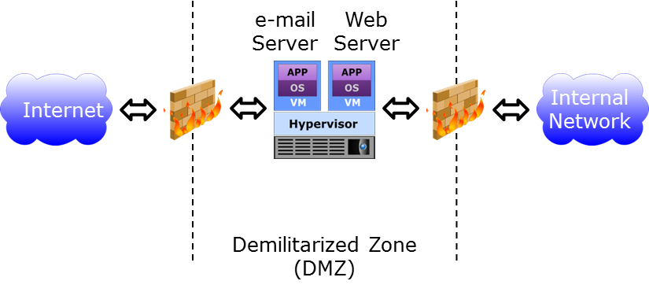
Firewall
Demilitarized Zone
Secure internal assets while allowing Internet-based access to resources
Notes:
Compute systems that are most vulnerable to attack are those that connect to an external network such as e-mail servers or web servers. These compute systems are exposed not only to the external network, but also require access to resources such as storage or end-user machines on the internal network. To reduce vulnerability, the exposed compute systems or virtual machines are placed in a demilitarized zone. A demilitarized zone is a mechanism to secure internal assets while allowing Internet-based access to selected resources. In a demilitarized zone environment, servers that need Internet access are placed between two sets of firewalls, as illustrated in the figure on the slide. The servers in the demilitarized zone may or may not be allowed to communicate with internal resources. Application-specific ports such as those designated for HTTP or FTP traffic are allowed through the firewall to the demilitarized zone servers. However, no Internet-based traffic is allowed to go through the second set of firewalls and gain access to the internal network.

Slide 56
Intrusion Detection and Prevention System
Intrusion Detection and Prevention System
A security tool that automates the process of detecting and preventing events that can compromise the confidentiality, integrity, or availability of IT resources.
Signature-based detection technique
Scans for signatures to detect an intrusion
Effective only for known threats
Anomaly-based detection technique
Scans and analyzes events to detect if they are statistically different from normal events
Has the ability to detect various events
Examples of events detected:
Multiple login failures
Excessive process failure
Excessive network bandwidth consumed by an activity
Notes:
Intrusion detection is the process of detecting events that can compromise the confidentiality, integrity, or availability of IT resources. An intrusion detection system (IDS) is a security tool that automates the detection process. An IDS generates alerts, in case, anomalous activity is detected. An intrusion prevention system (IPS) is a tool that has the capability to stop the events after they have been detected by the IDS. These two mechanisms usually work together and are generally referred to as intrusion detection and prevention system (IDPS). The key techniques used by an IDPS to identify intrusion in the environment are signature-based and anomaly-based detection.
In the signature-based detection technique, the IDPS relies on a database that contains known attack patterns, or signatures, and scans events against it. A signature can be an email with a specific subject or an email attachment with a specific file name that is known to contain a virus. This type of detection is effective only for known threats and is potentially circumvented if an attacker changes the signature (the email subject or the file name in the attachment, in this example). In the anomaly-based detection technique, the IDPS scans and analyzes events to determine whether they are statistically different from events normally occurring in the system. This technique can detect various events such as multiple login failures, excessive process failure, excessive network bandwidth consumed by an activity, or an unusual number of emails sent by a user, which could signify an attack is taking place.

Slide 57
Intrusion Detection and Prevention System
Types of implementations
IDPS Implementation | Description
Compute system-based | Analyzes activity such as system logs and running processes IDPS software is susceptible to attacks
Network-based | Monitors and analyzes network traffic, network devices, network protocol, and application protocol behavior Deployed in the form of appliance or software on compute system Usually isolated from malicious applications on compute systems
Hypervisor-based | Monitors for anomalies in a hypervisor Detection policies are typically kernel-specific
Notes:
The IDPS can be deployed at the compute system, network, or hypervisor levels. A compute system-based IDPS analyzes activity that includes system logs, running processes, application activities, file access and modification, and system and application configuration changes. Because IDPS software and malicious programs might be running on the same compute system, compute system-based IDPS is less isolated from attacks. In this scenario, the malicious program first attacks and disables IDPS and then carries out the main attack.
A network-based IDPS monitors network traffic and network devices. It also analyzes network and application protocols behavior for unusual activities. Network-based IDPS resides on the network in the form of an appliance or software installed on a dedicated compute system, and is usually isolated from malicious applications on the compute systems. After a network-based IDPS detects an anomaly, it stops the suspicious activity by dropping the packets or blocking ports. Since a network-based IDPS operates at the network level, it cannot monitor activities happening within the compute system.
A hypervisor-based IDPS is deployed at the hypervisor level. In this type of IDPS, detection policies are typically kernel-specific. Any anomaly detected in the kernel is immediately alerted or corrected depending on the specific IDPS configuration. Hypervisor-based IDPS is typically deployed in a cloud environment.

Slide 58
Adaptive Security
Adaptive Security
A mechanism that integrate with the cloud service providers’ standalone mechanisms such as IDPS and firewalls and use heuristics to learn user behavior and detect fraudulent activity.
Identifies and blocks anomalies
Parameters used to learn about a user are:
Behavioral profile
Device-related profile
Type of web browser being used
Plug-ins used in a browser
Notes:
Security threats have evolved to the point that traditional security mechanisms cannot respond to and be effective as standalone mechanisms. Sophisticated techniques such as phishing, Man in the Middle, and others are used to gain unauthorized access to cloud resources. To combat against such sophisticated attacks, cloud service providers require the use of adaptive security mechanisms. Adaptive security mechanisms integrate with the cloud service providers’ standalone mechanisms such as IDPS and firewalls and use heuristics to learn user behavior and detect fraudulent activity. Mechanisms such as behavioral profile, device-related profile, type of web browser, and plug-ins are used to establish the normal operating profile of the environment. The intelligence in the adaptive security mechanism detects and identifies anomalies and blocks such anomalies – capabilities that may not be possible with traditional mechanisms.

Slide 59
Virtual Private Network
Extends an consumer’s private network across a public network
Enables to apply internal network’s security and management policies over the VPN connection
Two methods to establish a VPN connection:
Remote access VPN connection
Remote client initiates a remote VPN connection request
VPN server authenticates and grants access to cloud network
Site-to-site VPN connection
Remote site initiates a site-to-site VPN connection
VPN server authenticates and grants access to cloud network
Notes:
In the cloud environment, a virtual private network (VPN) can be used to provide a consumer a secure connection to the cloud resources. VPN is also used in a hybrid cloud, externally hosted private cloud, or community cloud environment to provide secure site-to-site connection.
A virtual private network extends an consumer’s private network across a public network such as Internet. VPN establishes a point-to-point connection between two networks over which encrypted data is transferred. VPN enables consumers to apply the same security and management policies to the data transferred over the VPN connection as applied to the data transferred over the consumer’s internal network. When establishing a VPN connection, a consumer (user or an organization) is authenticated before the security and management policies are applied.
There are two methods in which a VPN connection can be established: remote access VPN connection and site-to-site VPN connection. In a remote access VPN connection, a remote client (typically client software installed on the consumer’s compute system) initiates a remote VPN connection request. A VPN server authenticates and provides the user access to the cloud network. In a site-to-site VPN connection, the remote site initiates a site-to-site VPN connection. The VPN server authenticates and provides access to internal network. One typical usage scenario for this method is when deploying a hybrid cloud, in which a cloud requires connection to another cloud’s network.

Slide 60
Virtual LAN and SAN
Ensure security by providing isolation over shared infrastructure
Restricting communication among different consumers
Zoning provides additional level of security within a VSAN
Notes:
In a cloud environment, VLAN and VSAN ensure security by providing isolation over the shared infrastructure. Each consumer may be provided VLANs and VSANs to ensure their data is separated from other consumers. A Virtual Local Area Network (VLAN) is a virtual network created on a local area network (LAN) consisting of virtual and/or physical switches. VLAN technology can divide a large LAN into smaller virtual LANs or combine separate LANs into one or more virtual LANs. A VLAN enables communication among a group of nodes based on the functional requirements of the group, independent of the nodes’ location in the network. Similarly, Virtual Storage Area Networks (VSAN) enable the creation of multiple logical SANs over a common physical SAN. They provide the capability to build larger consolidated fabrics and still maintain the required security and isolation between them. Zoning should be done for each VSAN to secure the entire physical SAN.

Slide 61
Zoning
Logically segments node ports into groups
Communication occur among node ports within a group
WWPN-based zoning prevents unauthorized access when node ports are re-cabled to different fabric ports
Port zoning reduces the risk of WWPN spoofing
Notes:
Zoning is a Fibre Channel switch mechanism that enables node ports within a fabric to be logically segmented into groups and to communicate with each other within the group. There are three types of zoning. World Wide Port Name-based zoning is the most commonly used to prevent unauthorized access when node ports are re-cabled to different fabric ports. However, it is possible that a rogue compute system could join the fabric, then spoof a legitimate WWPN and thereby gain access to resources in a zone. If WWPN spoofing is a key concern, then port zoning and port binding could be used.

Slide 62
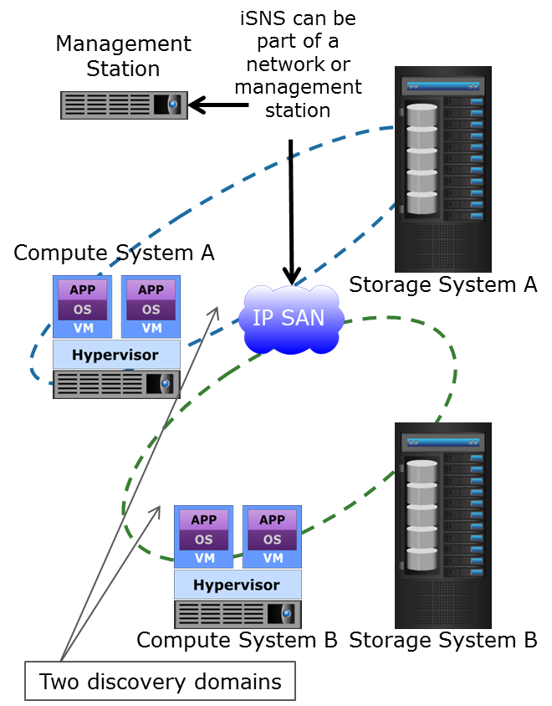
iSNS Discovery Domain
iSNS Discovery Domain
Function in the same way as FC zones
Enables functional groupings of devices in an IP-SAN
Devices in the same functional group can communicate with one another
Notes:
Internet Storage Name Service (iSNS) discovery domains function in the same way as FC zones. Discovery domains provide functional groupings of devices in an IP-SAN. For devices to communicate with one another, they must be configured in the same discovery domain. State change notifications inform the iSNS server when devices are added to or removed from a discovery domain. The figure on the slide illustrates the discovery domains in iSNS.

Slide 63
Port Binding
Port binding limits the devices that can be attached to a specific switch port
Supported Environment | Description
FC SAN | Maps a WWPN to a switch port WWPN login is rejected when illegitimate host is connected
Ethernet | Maps MAC and IP address of a compute system to a switch port Switch port forwards a packet only if a MAC and IP address in a packet are mapped to that port
Notes:
Port binding is a mechanism used to limit the devices that can be attached to a specific switch port and is supported in both FC SAN and Ethernet environments. In an FC SAN, port binding maps a WWPN to a switch port. If a host tries to login to a port with a WWPN that is not allowed by the port binding, the WWPN login is rejected. In an Ethernet network, port binding maps the MAC address and IP address of a compute system to a specific switch port. A switch port will forward a packet only if the MAC and IP address in the packet are mapped to that port. Port binding mitigates but does not eliminate WWPN or MAC spoofing.

Slide 64
Fabric Binding
Fabric binding allows only authorized switches to join a fabric
Ensures unauthorized switches are segmented from a fabric
Authorized switch can merge into a fabric
Can be used along with port and port-type locking capabilities
Notes:
Fabric binding is another security mechanism in an FC SAN environment that allows only authorized switches to join an existing fabric. Inter-switch links are only enabled between specified switches in the fabric. Each switch in the fabric obtains identical membership data that includes a list of authorized switches in the fabric. Port security controls such as port locking and port-type locking complement fabric binding by helping to prevent unauthorized access to a switch. Port locking persistently (even after a switch reboot) prohibits an unused switch port from being used. Port-type locking can be used to restrict how a specific switch port is used, such as preventing it from being initialized as an inter-switch link.

Slide 65
Lesson Summary
During this lesson the following topics were covered:
Role-based access control
Network monitoring and analysis
Firewall, IDPS, and adaptive security
Port binding and fabric binding
VPN, VLAN, and VSAN
Zoning and iSNS discovery domain
Notes:
This lesson covered role-based access control, network monitoring and analysis, firewall, intrusion detection and prevention system, adaptive security, port binding and fabric binding, VPN, VLAN, VSAN, zoning, and iSNS discovery domain.

Slide 66
Lesson: Security Mechanisms – III
This lesson covers the following topics:
Security hypervisor and management server
Virtual machine hardening
Securing operating system and applications
LUN masking
Data encryption
Data shredding
Notes:
This lesson covers security hypervisor and management server, virtual machine hardening, securing operating system and applications, LUN masking, data encryption, and data shredding mechanisms deployed in a cloud environment.

Slide 67
Key Security Mechanisms
Physical security
Identity and access management
Role-based access control
Network monitoring and analysis
Firewall
Intrusion detection and prevention system
Adaptive security
Port binding and fabric binding
Virtual private network
Virtual LAN and virtual SAN
Zoning and iSNS discovery domain
Security hypervisor and management server
Virtual machine hardening
Securing operating system and applications
LUN masking
Data encryption
Data shredding

Slide 68
Securing Hypervisor and Management Server
Compromising a hypervisor or management server places all VMs at risk
Control measures:
Install security-critical hypervisor updates
Harden hypervisor using specifications provided by CSI and DISA
Restrict core functionality to selected administrators
Encrypt network traffic when managing remotely
Deploy firewall between management system and rest of the network
Rotate or delete log files when they reach a certain size
Notes:
The hypervisor and related management servers are critical components of the cloud infrastructure because they control the operation and management of the virtualized compute environment. Compromising a hypervisor or management server places all VMs at a high risk of attack. Hypervisors may be compromised by hyperjacking or other forms of attack. Further, the management server may be compromised by exploiting vulnerabilities in the management software or by an insecure configuration. For example, an administrator may have configured a non-secured or non-encrypted remote access mechanism. Also, a malicious attacker may take control of the management server by exploiting a security loophole of the system. This enables the attacker to perform unauthorized activities such as controlling all the existing VMs, creating new VMs, deleting VMs, and modifying VM resources.
To protect against such attacks, security-critical hypervisor updates should be installed when they are released by the hypervisor vendor. Hypervisor hardening should be performed, using specifications provided by organizations such as the Center for Internet Security (CIS) and Defense Information Systems Agency (DISA). Access to the management server should be restricted to authorized administrators. Access to core levels of functionality should be restricted to selected administrators. Also, network traffic should be encrypted when management is performed remotely. A separate firewall with strong filtering rules installed between the management system and the rest of the network can enhance security.
Virtual machines store troubleshooting information in a log file that is stored on the storage presented to a hypervisor. An attacker may cause a virtual machine to abuse the logging function, causing the size of the log file to grow rapidly. Over time, the log file can consume all the capacity of the storage presented to the hypervisor, effectively causing a denial of service. This can be prevented by configuring the hypervisor to rotate or delete log files when they reach a certain size. This option enables the administrator to configure the maximum size of the log file. When this size is reached, the hypervisor makes an archive copy of the log file and starts storing information in a new log file. Administrators can configure settings to maintain a specific number of old log files. When the configured limit is reached, the hypervisor automatically deletes the oldest file.

Slide 69
Virtual Machine Hardening
Process used to change the default configuration of a VM
Removed or disabled devices that are not required
Example: disabling USB ports or CD/DVD drives
Tune configuration of VM features to operate in secure manner:
Change default passwords
Set permissions to VM files
Disallow changes to MAC address assigned to a virtual NIC
VM templates must be hardened to a known security baseline
Notes:
Virtual machine hardening is a key security mechanism to protect virtual machines from various attacks. Typically, a virtual machine is created with several default virtual components and configurations. Some of the configurations and components may not be used by the operating system and application running on it. These default configurations may be exploited by an attacker to carry out an attack. Therefore, a virtual machine hardening process should be used in which the default configuration is changed to achieve greater security. In this process, virtual machine’s devices that are not required (such as USB ports or CD/DVD drives) are removed or disabled. Also, in this process the configuration of VM features is tuned to operate in a secure manner such as changing default passwords, setting permissions to VM files, and disallowing changes to the MAC address assigned to a virtual NIC, mitigating spoofing attacks. Hardening is highly recommended when creating virtual machine templates. This way, virtual machines created from the template start from a known security baseline.

Slide 70
Securing Operating Systems and Applications
Three key security mechanisms for OS and application:
Hardening OS and applications
Malware protection software
Sandboxing
Notes:
Hardening, malware protection software, and sandboxing are the three key mechanisms that can increase the resistance of guest operating systems and applications to exploitation by malicious attackers.

Slide 71
Hardening OS and Applications
OS hardening:
Configure system and network components as per a hardening checklist provided by CIS and DISA
Delete unused files and applications, and install current OS updates
Perform vulnerability scan and penetration test to identify existing vulnerabilities
Application hardening:
Design with proper architecture, threat modeling, and secure coding
Installing current application updates
Notes:
Operating system hardening typically includes deleting unused files and applications, installing current operating system updates (patches), and configuring system and network components following a hardening checklist. These hardening checklists are typically provided by operating systems vendors or organizations such as the Center for Internet Security (CIS) and Defense Information Systems Agency (DISA), who also provide security best practices. Further, vulnerability scanning and penetration testing can be performed to identify existing vulnerabilities and to determine the feasibility of an attack. These mechanisms assess the potential impact of an attack on the business. Consumer-driven penetration tests and vulnerability scanning may not be allowed by the cloud service providers. Consumers may have to rely on the cloud service provider to perform these tests.
Application hardening is a process followed during application development, with the goal of preventing the exploitation of vulnerabilities that are typically introduced during the development cycle. Application architects and developers must focus on various factors such as proper application architecture, threat modeling, and secure coding while designing and developing an application. Installing current application updates or patches provided by the application developers can reduce some of the vulnerabilities identified after the application is released.

Slide 72
Malware Protection Software
Detects, prevents, and removes malware programs
Common malware detection techniques:
Signature-based detection
Heuristics detection
Protect applications by providing:
Process spawning control
Executable file protection
System tampering protection
Protects OS against attacks that modifies sensitive areas
Disallows unauthorized modification of sensitive areas
Virus code incorporated into application’s executable file
Virus code executed when infected application runs
Can be prevented by:
Disallowing modification of application’s executable file
Notes:
Malware protection software is typically installed on a compute system or as a virtual appliance to provide protection for the operating system and applications. The malware protection software detects, prevents, and removes malware and malicious programs such as viruses, worms, Trojan horses, key loggers, and spyware. Malware protection software uses various techniques to detect malware. One of the most common techniques used is signature-based detection. In this technique, the malware protection software scans the files to identify a malware signature. A signature is a specific bit pattern in a file. These signatures are catalogued by malware protection software vendors and are made available to users as updates. The malware protection software must be configured to regularly update these signatures to provide protection against new malware programs. Another technique, called heuristics, can be used to detect malware by examining suspicious characteristics of files. For example, malware protection software may scan a file to determine the presence of rare instructions or code. Malware protection software may also identify malware by examining the behavior of programs. For example, malware protection software may observe program execution to identify inappropriate behavior such as keystroke capture.
Application hardening mechanisms include process spawning control, executable file protection, and system tampering protection. A common type of attack that can be imparted on applications tampering with executable files. In this type of attack, virus code is incorporated into the application’s executable files. When the infected application runs, the virus code is also executed. This type of attack can be prevented by disallowing the application executable from being modified. Countermeasures for this type of attack are typically implemented in operating system configuration settings or via malware protection software. When an attempt of modification is performed, the OS or the malware protection stops the modification of the executable files.
(Cont'd)

Slide 73
Malware Protection Software
Detects, prevents, and removes malware programs
Common malware detection techniques:
Signature-based detection
Heuristics detection
Protect applications by providing:
Process spawning control
Executable file protection
System tampering protection
Protects OS against attacks that modifies sensitive areas
Disallows unauthorized modification of sensitive areas
Virus code incorporated into application’s executable file
Virus code executed when infected application runs
Can be prevented by:
Disallowing modification of application’s executable file
Notes:
Malware protection software can also be used to protect operating system against attacks. A common type of attack that is carried out on operating systems is by modifying its sensitive areas, such as registry keys, with the intention of causing the application to function incorrectly or to fail. This can be prevented by disallowing the unauthorized modification of sensitive areas by adjusting operating system configuration settings or via malware protection software. In this case, when a modification is attempted, the operating system or the malware protection software prompts the administrator for authorization.

Slide 74
Sandboxing
Provides a tightly-controlled set of resources on which the application executes
Used for testing and verifying unproven or untrusted applications
Isolates execution of an application in order to restrict the resources and privileges
Notes:
Sandboxing is another mechanism for guest operating system and application security. Typically used for testing and verifying unproven or untrusted applications, sandboxing involves isolating the execution of an application from other applications in order to restrict the resources and privileges that the application has access to. The restrictions are enforced via the operating system. When creating a sandbox environment an administrator defines resources that an application can access while being tested. For example, network access and the ability to inspect the system components or reading from input devices are either disallowed or restricted and closely monitored.

Slide 75
LUN Masking
LUN Masking
Refers to the assignment of LUNs to specific host bus adapter world-wide names.
Protect against unauthorized access to storage
Can be implemented on:
Host
Switch
Storage system
Stronger variant of LUN masking uses source Fibre Channel address
Notes:
LUN masking refers to the assignment of LUNs to a specific host bus adapter world-wide names. LUN masking is one of the basic SAN security mechanisms used to protect against unauthorized access to storage. LUN masking can be implemented at the host within the switch or at the storage system. The standard implementations of LUN masking on storage arrays mask the LUNs presented to a front-end storage port based on the WWPNs of the source HBAs. A stronger variant of LUN masking may sometimes be offered in which masking is done on the basis of the source Fibre Channel address. The Fibre Channel address typically changes if the HBA is relocated across ports in the fabric. To avoid this problem, most switch vendors offer a mechanism to lock down the Fibre Channel address of a given node port regardless of its location.

Slide 76
Data Encryption
Data Encryption
A cryptographic technique in which data is encoded and made indecipherable to eavesdroppers or hackers.
Enables securing data in-flight and at-rest
Provides protection from threats, such as data tampering, media theft, and sniffing attacks
Data encryption mechanism can be deployed at compute, network, and storage
Data should be encrypted as close to its origin as possible
Notes:
Data encryption is a cryptographic technique in which data is encoded and made indecipherable to eavesdroppers or hackers. Data encryption is one of the most important mechanisms for securing data in-flight and at-rest. Data in-flight refers to data that is being transferred over a network and data at-rest refers to data that is stored on a storage medium. Data encryption provides protection from threats such as tampering with data which violates data integrity, media theft which compromises data availability, and confidentiality and sniffing attacks which compromise confidentiality.
Data should be encrypted as close to its origin as possible. If it is not possible to perform encryption on the compute system, an encryption appliance can be used for encrypting data at the point of entry into the storage network. Encryption devices can be implemented on the fabric to encrypt data between the compute system and the storage media. These mechanisms can protect both the data at-rest on the destination device and data in-transit. Encryption can also be deployed at the storage-level, which can encrypt data-at-rest.
Another way to encrypt network traffic is to use cryptographic protocols such as Transport Layer Security (TLS) which is a successor to Secure Socket Layer (SSL). These are application layer protocols and provide an encrypted connection for client-server communication. These protocols are designed to prevent eavesdropping and tampering of data on the connection over which it is being transmitted.
Some cloud providers may perform data mining and analytics on consumers’ data so that they can offer new services to them based on their usage and nature of data. However, this may cause consumers to be concerned about the loss of confidentiality of their data, even if the cloud provider does not misuse the data. Therefore, a provider may offer data encryption capability to protect consumers’ data.

Slide 77
Data Shredding
Data Shredding
A process of deleting data or residual representations (sometimes called remanence) of data and making it unrecoverable
Techniques for shredding data stored on tapes:
Overwriting tapes with invalid data
Degaussing media
Destroying tapes
Techniques for shredding data stored on disks and flash drives:
Shredding algorithms
Shred all copies of data including backup and replicas
Notes:
Data shredding is the process of deleting data or residual representations (sometimes called remanence) of data and making it unrecoverable. Typically, when data is deleted, it is not made unrecoverable from the storage and an attacker may use specialized tools to recover it. The threat of unauthorized data recovery is greater in the cloud environment as consumers do not have control over cloud resources. After consumers discontinue the cloud service, their data or residual representations may still reside in the cloud infrastructure. An attacker may perform unauthorized recovery of consumers’ data to gain confidential information.
Cloud service providers can deploy data shredding mechanisms in the cloud infrastructure to protect from loss of confidentiality of consumers’ data. Data may be stored on disks or on tapes. Techniques to shred data stored on tape include overwriting it with invalid data, degaussing the media (a process of decreasing or eliminating the magnetic field), and physically destroying the tape. Data stored on disk or flash drives can be shredded by using algorithms that overwrite the disks several times with invalid data.
Cloud service providers may create multiple copies (backups and replicas) of consumer’s data at multiple locations as part of business continuity and disaster recovery strategy. Therefore, cloud service providers must deploy data shredding mechanism at all location to ensure that all the copies are shred.

Slide 78
Security as a Service
Security as a Service
Refers to the provision of security applications and services via the cloud either to cloud-based infrastructure and software or from the cloud to the customers’ on-premise systems. This will enable enterprises to make use of security services in new ways, or in ways that would not be cost effective if provisioned locally.
— Cloud Security Alliance, “Security as a Service” Version 1.0 (2011)
Enables consumers to reduce CAPEX on security deployments
Enables reducing security management burden on consumers
Security policies implemented are dictated by consumers
Notes:
Today, cloud computing has enabled small and medium organizations to have robust security mechanisms without requiring capital investment in security tools or staff expertise. This is possible because some cloud service providers are providing Security as a Service.
Security as a Service (SecaaS) is a service that delivers various security mechanisms through the cloud. Typically, Security as a Service offers mechanisms such as identity and access management, data loss prevention, security information and event management, web security, email security, security assessments, intrusion detection and prevention, encryption, and business continuity and disaster recovery.
Security as a Service provides consumers the opportunity to reduce their capital investment on their security deployments and still enjoy robust security mechanisms. It also reduces the security management burden on the organization and enables them to focus on their core competencies. Security as a Service provides several benefits such as agility, dynamic scalability, and virtually unlimited resources. The challenge associated with Security as a Service is that, as in every SaaS deployment, consumers do not have complete visibility and control over the service. The consumer is responsible for setting the security policies but the service is managed by the service provider.
Having robust security mechanisms and technology in place is very important to any cloud environment. However, technologies alone are not enough to guarantee information security. Cloud service providers need to deploy Governance, Risk and Compliance (GRC) processes before offering cloud services to their consumers.

Slide 79
Lesson Summary
During this lesson the following topics were covered:
Security hypervisor and management server
Virtual machine hardening
Securing operating system and applications
LUN masking and data encryption
Data shredding and security as a Service
Notes:
This lesson covered security hypervisor and management server, virtual machine hardening, securing operating system and applications, LUN masking, data encryption, data shredding and Security as a Service.

Slide 80
Lesson: Governance, Risk, and Compliance (GRC)
This lesson covers the following topics:
Focus areas of cloud governance
Key steps of risk management
Types of compliance that control IT operations in cloud
Key auditing activities in cloud
Notes:
This lesson covers focus areas of cloud governance, key steps of risk management, types of compliance that control IT operations in cloud, and key auditing activities in cloud.

Slide 81
Introduction to GRC
GRC
A term encompassing processes that help an organization to ensure that their acts are ethically correct and in accordance with their risk appetite (the risk level an organization chooses to accept), internal policies and external regulations.
GRC work together to enforce policies and minimize risks
Governance is the authority for making policies
Risk management involves identifying resources that should not be accessed by certain users to preserve CIA
Compliance management assures that policies are being enforced by implementing mechanisms
Notes:
Governance, Risk, and Compliance (GRC) is a term encompassing processes that help an organization to ensure that their acts are ethically correct and in accordance with their risk appetite (the risk level an organization chooses to accept), internal policies and external regulations. This process should be integrated, holistic, and organization-wide. All operations of an organization should be managed and supported through GRC.
Governance, risk management, and compliance management work together to enforce policies and minimize potential risks. To better understand how these three components work together, consider an example of how GRC is implemented in an IT organization. Governance is the authority for making policies such as defining access rights to users based on their roles and privileges. Risk management involves identifying resources that should not be accessed by certain users in order to preserve confidentiality, integrity, and availability. In this example, compliance management assures that the policies are being enforced by implementing mechanisms such as firewalls and identify management systems.
GRC is an important component of cloud infrastructure. Therefore, while building a cloud infrastructure service provider must ensure that all aspects of GRC are deployed that includes cloud-related aspects such as ensuring secured multi-tenancy, the jurisdictions where data should be stored, data privacy, and ownership.
In case an organization is transforming its data center to provide a cloud infrastructure already have some form of GRC in effect. In such cases, the organizations may only have to focus on the cloud-related aspects of GRC.

Slide 82
Governance
Governance
Determine the purpose, strategy, and operational rules by which companies are directed and managed.
Enterprise governance is based on business strategy
IT governance is a subset discipline of enterprise governance
Objective of IT governance is to determine desired behavior to achieve IT’s strategic goals
IT governance requires defining roles and responsibilities for:
Directing, controlling, and executing decisions
Determining information required to make decisions
Handling exceptions
Notes:
Governance determine the purpose, strategy, and operational rules by which companies are directed and managed. Enterprise Governance is based on the company’s business strategy and driven by the Board of Directors. It generally includes legal, HR, finance, and the office of the CEO. Governance affects how the company addresses everything from long-term strategies to day-to-day operations. The slide focuses on IT Governance, which is a subset discipline of Enterprise Governance.
The objective of IT governance is to determine the desired behavior or results to achieve IT’s strategic goals. Governance in IT is a system in which leaders monitor, evaluate, and direct IT management to ensure IT effectiveness, accountability, and compliance. For a governance system to work, it has to distribute the workload and decision making process without losing value or gaining bias in the process. Roles and responsibilities must be clearly defined, providing details, such as who is responsible for directing, controlling and executing decisions, what information is required to make the decisions, and how exceptions will be handled. The last step is to measure the outcome of the governance process, finding areas for improvement, and instituting changes for improvement.
The basic principles of IT governance remain the same in cloud environments. Additionally, cloud service provider must focus on policies related to managing and consuming cloud services.

Slide 83
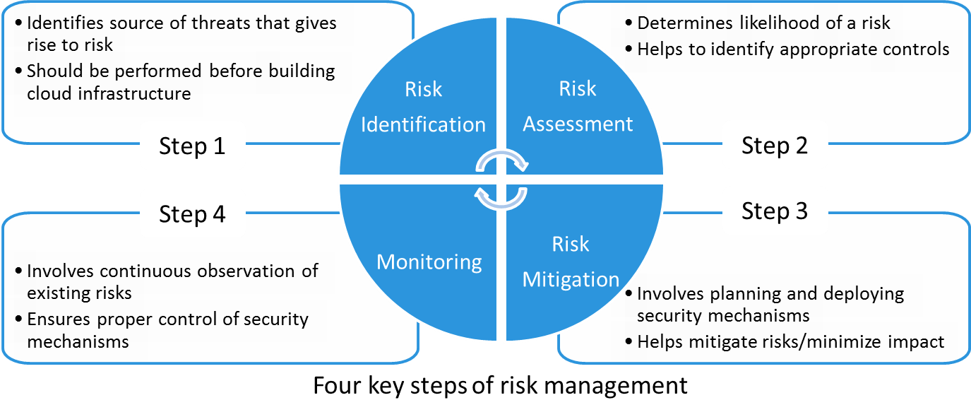
Risk Management
Risk and Risk Management
Risk is the effect of uncertainty on business objectives. Risk management is a systematic process of assessing its assets, placing a realistic valuation on each asset, and creating a risk profile that is rationalized for each information asset across the business.
Notes:
Risk is the effect of uncertainty on business objectives. Risk management is a systematic process of assessing its assets, placing a realistic valuation on each asset, and creating a risk profile that is rationalized for each information asset across the business. Additionally, the cloud service providers must establish a risk threshold to measure against each asset. Cloud computing poses several new risks beyond those that exist in traditional data centers. Risk management involves identification, assessment, and prioritization of risks and institutes controls to minimize the impact of those risks.
There are four key steps of risk management that a cloud service provider must perform before offering services to the consumers: risk identification, risk assessment, risk mitigation, and monitoring. These steps are elaborated below:
Step 1: Risk identification points to the various sources of threats that give rise to risk. After identifying risks in a cloud, these risks and their sources need to be classified into meaningful severity levels.
Step 2: Risk assessment determines the extent of potential threat and the risk associated with cloud resources. The output of this process helps cloud service provider to identify appropriate controls for reducing or eliminating risk during the risk mitigation process. All the assets at risk (data, applications, and processes) must be carefully evaluated to assess their criticality to the consumers. Critical assets are assets that are essential for the operation of the consumers’ business and have high business value, such as intellectual property (IP), project plans, and Personally Identifiable Information (PII). After the risks are assessed, the critical assets should be associated with potential risks. For example, a company’s IP records can be identified as critical assets, and data disclosure could be a risk of high severity level.
Step 3: Risk mitigation involves planning and deploying various security mechanisms (such as those discussed in security mechanisms lessons) that can either mitigate the risks or minimize the impact of the risks.
(Cont'd)

Slide 84
Risk Management
Risk and Risk Management
Risk is the effect of uncertainty on business objectives. Risk management is a systematic process of assessing its assets, placing a realistic valuation on each asset, and creating a risk profile that is rationalized for each information asset across the business.
Notes:
Step 4: Monitoring involves continuous observation of existing risks and security mechanisms to ensure their proper control. Monitoring can be performed using inputs from deployed security mechanisms, such as firewalls, IDPS, and malware protection software. These security mechanisms typically have alerts configured to indicate any observed malicious activity or security breaches. Also, this step observes new risks that may arise. If a new risk is identified then the entire process is repeated.

Slide 85
Compliance
Compliance
Act of adhering to, and demonstrating adherence to, external laws and regulations, corporate policies and procedures, service provider's own demands, consumers' demands, and/or the demands of participating cloud providers (in case of hybrid cloud and cloud brokers).
Two types of compliance policies control IT operations:
Internal policy compliance
Controls the nature of IT operations within an organization
Require maintaining same compliance when operating in cloud
External policy compliance
Controls the nature of IT operations related to the flow of data out of organization
May differ based upon the type of information, and business
Notes:
Compliance is the act of adhering to, and demonstrating adherence to, external laws and regulations as well as to corporate policies and procedures. It also involves adhering to, and demonstrating adherence to the service provider's own demands, consumers’ demands, and/or the demands of participating cloud providers (in case of hybrid cloud and cloud brokers). For example, security demands that are expressed in contracts, decisions on best practice, or specific standards. While building and offering cloud services to consumers, it is important to assess compliance against regulations and demands (discussed earlier). Also, it is important to review the security and privacy controls that are in place to ensure that appropriate controls are applied to the highest value and highest risk assets.
While transforming an existing data center into cloud, the compliance and audit standards, processes, and practices are likely to exist for the data center environment. However, transforming to cloud requires significant adjustments to the existing compliance framework.
Adhering to policies and regulations applies to both cloud service provider and consumers. There are primarily two types of policies controlling IT operations in an enterprise that require compliance even after moving operations to cloud: internal policy compliance and external policy compliance.
Internal policy compliance controls the nature of IT operations within an organization. An organization needs to maintain the same compliance when operating in cloud. This requires clear assessment of the potential difficulties in maintaining the compliance in a cloud and processes to ensure that this is effectively achieved.
(Cont'd)

Slide 86
Compliance
Compliance
Act of adhering to, and demonstrating adherence to, external laws and regulations, corporate policies and procedures, service provider's own demands, consumers' demands, and/or the demands of participating cloud providers (in case of hybrid cloud and cloud brokers).
Two types of compliance policies control IT operations:
Internal policy compliance
Controls the nature of IT operations within an organization
Require maintaining same compliance when operating in cloud
External policy compliance
Controls the nature of IT operations related to the flow of data out of organization
May differ based upon the type of information, and business
Notes:
External policy compliance includes legal requirements, legislation, and industry regulations. These external compliance policies control the nature of IT operations related to the flow of data out of an organization. They may differ based upon the type of information (for example, source code versus employee records), and business (for example, medical services versus financial services).
Governments around the world are imposing regulatory controls for data stored in cloud such as data residency laws and information flow regulations. These regulations govern what type of information can or cannot cross jurisdictional boundaries. For example, financial data may be restricted from crossing a regional boundary. Among various cloud deployment models, organizations deploying on-premise private clouds can offer the maximum information flow regulation because the control over data remains fully with them. To meet such regulatory compliance, public cloud service providers should offer an option for their consumers to choose the location where the data should be stored. Selecting among these options in response to regulatory constraints is another function of cloud governance.

Slide 87
Compliance Management
Compliance Management
Ensures that the cloud services, service creation processes, and cloud infrastructure resources adhere to relevant policies and legal requirements.
Policies and regulations may be based on:
Configuration best practices
Security rules
Change control processes
Compliance management activities include:
Periodic review of compliance enforcement
Identifying deviations and initiating corrective actions
Notes:
In order to meet a consumer’s compliance requirements, the cloud service provider must have compliance management in place. Compliance management ensures that the cloud services, service creation processes, and cloud infrastructure resources adhere to relevant policies and legal requirements. Policies and regulations can be based on configuration best practices and security rules. These include administrator roles and responsibilities, physical infrastructure maintenance timelines, information backup schedules, and change control processes. Compliance management activity includes periodically reviewing compliance enforcement in infrastructure resources and services. If it identifies any deviation from compliance requirements, it initiates corrective actions.

Slide 88
Auditing
Auditing
A process that determines the validity and reliability of information about the enforcement of controls presented by a provider. Audit also provides an assessment of the cloud provider’s control mechanisms and their ability to provide the consumers, the logs required to verify the mechanisms.
Performed by internal auditors or external auditors
Cloud auditor is a role that audits cloud infrastructure
Evaluates a provider in terms of:
Security controls
Privacy
Notes:
In the compliance context, audit is a process that determines the validity and reliability of information about the enforcement of controls presented by a provider. Audit also provides an assessment of the cloud provider’s control mechanisms and their ability to provide the consumers the logs required to verify the mechanisms. Auditing of the cloud infrastructure can be performed by internal auditors (an auditing team within the organization) or external auditors (from an external organization). The role that carries out this activity is referred as cloud auditor.
A cloud auditor is any party that can conduct an independent assessment of cloud services, information system operations, performance and security of the cloud implementation. A cloud auditor can evaluate the services provided by a cloud provider in terms of security controls and privacy.

Slide 89
Key Auditing Activities in the Cloud
Security Audit
Determine how consumers’ data is segregated from each other
Evaluate security mechanisms and ensure they are in accordance with provider’s internal policies
Determine how identity management is performed
Determine whether adequate DR processes are available
Evaluate whether appropriate governance processes are available
Notes:
The cloud auditor makes an independent assessment of the security controls in the information system to determine if they meet the requirements and are running as originally intended. Key activities that provide the basis for a security audit of a cloud infrastructure include:
Determine how consumers’ data is segregated from each other.
Review and evaluate the security mechanisms to detect, prevent, and stop an attack in accordance with provider’s internal policies. Also, review and evaluate physical security.
Determine how identity management is performed for cloud-based services.
Determine whether adequate disaster recovery processes are available to provide consumers uninterrupted access to the cloud services.
Review and evaluate whether appropriate governance processes are available to meet consumers’ requirements.

Slide 90
Key Auditing Activities in the Cloud
Privacy Audit
Evaluate use of encryption to protect consumers’ data
Determine level of access provider’s employees have to consumers’ resources and data
Evaluate processes for controlling consumers’ access
Evaluate whether data retention and destruction practices are in accordance with privacy laws
Notes:
In a privacy audit, the cloud auditor performs an assessment of the processes and mechanisms deployed in the cloud infrastructure to determine whether a cloud provider meets relevant privacy regulations.
The key activities based on which privacy audit of a cloud infrastructure is performed include:
Review and evaluate the usage of encryption to protect consumers’ data that is stored on the providers’ infrastructure or is transmitted over the network.
Determine the level of access the provider’s employees have to consumers’ resources and data. Also, determine how the access of the provider’s employees is controlled.
Review and evaluate processes for controlling consumers’ access to the cloud resources.
Review and evaluate whether data retention and destruction practices are in accordance with privacy laws.

Slide 91
Lesson Summary
During this lesson the following topics were covered:
Governance in the cloud
Risk management for the cloud
Compliance for the cloud
Cloud auditing
Notes:
This lesson covered governance in the cloud, risk management for the cloud, compliance management for the cloud, and cloud auditing.

Slide 92
Concepts in Practice
RSA SecurID
RSA Security Analytics
RSA Archer eGRC
RSA Adaptive Authentication
VMware vCloud Networking and Security
Notes:
This Concepts in Practice section covers RSA and VMware security products. These products are RSA SecurID, RSA Adaptive Authentication, RSA Security Analytics, RSA Archer eGRC, and VMware vCloud Networking and Security.
Note:
For the latest information on RSA products, visit www.emc.com.
For the latest information on VMware products, visit www.vmware.com.

Slide 93
RSA Security Products
SecurID |  | Security Analytics |  | Archer eGRC
Provides two-factor authentication To access a resource, a user must combine their secret PIN with token code New token code is generated every 60 seconds |  | Enables to detect and investigate threats often missed by other security tools Single platform captures and analyzes large amounts of network, logs, and other data Enables analysis of terabytes of metadata, log data, and recreated network sessions |  | Enables organization to: Manage risks Demonstrate compliance Automate business processes Gain visibility to corporate risk and security controls Provides a single point of visibility and coordination for physical, virtual, and cloud assets
Notes:
RSA SecurID two-factor authentication provides an added layer of security to ensure that only valid users have access to systems and data. RSA SecurID is based on something a user knows (a password or PIN) and something a user has (an authenticator device). It provides a much more reliable level of user authentication than reusable passwords. It generates a new, one-time token code every 60 seconds, making it difficult for anyone other than the genuine user to input the correct token code at any given time. To access their resources, users combine their secret Personal Identification Number (PIN) with the token code that appears on their SecurID authenticator display at that given time. The result is a unique, one-time password used to assure a user’s identity.
RSA Security Analytics helps security analysts detect and investigate threats often missed by other security tools. Security Analytics provides converged network security monitoring and centralized security information and event management (SIEM). Security Analytics combines big data security collection, management, and analytics; full network and log-based visibility; and automated threat intelligence – enabling security analysts to better detect, investigate, and understand threats they often could not easily see or understand before. It provides a single platform for capturing and analyzing large amounts of network, log, and other data. Also, it accelerates security investigations by enabling analysts to pivot through terabytes of metadata, log data, and recreated network sessions. It archives and analyzes long-term security data through a distributed computing architecture and provides built-in compliance reports covering a multitude of regulatory regimes.
(Cont'd)

Slide 94
RSA Security Products
SecurID |  | Security Analytics |  | Archer eGRC
Provides two-factor authentication To access a resource, a user must combine their secret PIN with token code New token code is generated every 60 seconds |  | Enables to detect and investigate threats often missed by other security tools Single platform captures and analyzes large amounts of network, logs, and other data Enables analysis of terabytes of metadata, log data, and recreated network sessions |  | Enables organization to: Manage risks Demonstrate compliance Automate business processes Gain visibility to corporate risk and security controls Provides a single point of visibility and coordination for physical, virtual, and cloud assets
Notes:
RSA Archer eGRC solutions allow an organization to build an efficient, collaborative enterprise governance, risk and compliance (eGRC) program across IT, finance, operations and legal domains. With RSA Archer eGRC, an organization can manage risks, demonstrate compliance, automate business processes, and gain visibility into corporate risk and security controls. RSA delivers several core enterprise governance, risk, and compliance solutions, built on the RSA Archer eGRC Platform. Business users have the freedom to tailor the solutions and integrate with multiple data sources through code-free configuration.
These solutions include:
Policy Management: Centrally manage policies, map them to objectives and guidelines, and promote awareness to support a culture of corporate governance.
Risk Management: Identify risks to the business, evaluate them through online assessments and metrics, and respond with remediation or acceptance.
Compliance Management: Documents control framework, assess design and operational effectiveness, and respond to policy and regulatory compliance issues.
Enterprise Management: Manage relationships and dependencies within an enterprise’s hierarchy and infrastructure to support GRC initiatives.
Incident Management: Report incidents and ethics violations, manage their escalation, track investigations, and analyze resolutions.
Vendor Management: Centralize vendor data, manage relationships, assess vendor risk, and ensure compliance with organization’s policies and controls.
Threat Management: Track threats through a centralized early warning system to help prevent attacks before they affect an enterprise.
Business Continuity Management: Automate the enterprise’s approach to business continuity and disaster recovery planning, and enable rapid and effective crisis management in one solution.
Audit Management: Centrally manage the planning, prioritization, staffing, procedures and reporting of audits to increase collaboration and efficiency.
RSA Archer eGRC platform is an advanced security management system that provides a single point of visibility and coordination for physical, virtual, and cloud assets. Its three layers—controls enforcement, controls management, and security management—work together to provide a single view of information, infrastructure, and identities across physical and virtual environments.

Slide 95
RSA and VMware Security Products
RSA Adaptive Authentication |  | VMware vCloud Networking and Security
Provides an authentication and fraud detection platform Measures login and post-login activities by evaluating risk indicators Provides transparent authentication when protecting: Web sites and online portals Mobile applications and browsers ATM, SSL, and VPN Web access management applications |  | Virtualizes networking and security to enable greater agility, efficiency and, extensibility in the data center Delivers software-defined networks and security with a broad range of services including: Virtual firewall Virtual private network Load balancer VXLAN
Notes:
RSA Adaptive Authentication is a comprehensive authentication and fraud detection platform. Adaptive Authentication is designed to measure the risk associated with a user’s login and post-login activities by evaluating a variety of risk indicators. Using a risk and rules based approach, the system then requires additional identity assurance, such as out-of-band authentication, for scenarios that are high risk and violate a policy. This methodology provides transparent authentication for organizations that want to protect users accessing web sites and online portals, mobile applications and browsers, Automated Teller Machines (ATMs), Secure Sockets Layer (SSL), virtual private network (VPN) applications, web access management (WAM) applications, and application delivery solutions.
VMware vCloud Networking and Security virtualizes networking and security to enable greater agility, efficiency, and extensibility in the data center. vCloud Networking and Security delivers software-defined networks and security with a broad range of services, which includes a virtual firewall, virtual private network, load balancing and VXLAN extended networks.
These services are discussed below:
Virtual firewall: Stateful inspection firewall that can be applied either at the perimeter of the virtual data center or at the virtual network interface card (vNIC) level directly in front of specific workloads. The firewall-rule table is designed for ease of use and automation with VMware vCenter objects for simple and reliable policy creation. Stateful failover enables high availability for business-critical applications.
(Cont'd)

Slide 96
RSA and VMware Security Products
RSA Adaptive Authentication |  | VMware vCloud Networking and Security
Provides an authentication and fraud detection platform Measures login and post-login activities by evaluating risk indicators Provides transparent authentication when protecting: Web sites and online portals Mobile applications and browsers ATM, SSL, and VPN Web access management applications |  | Virtualizes networking and security to enable greater agility, efficiency and, extensibility in the data center Delivers software-defined networks and security with a broad range of services including: Virtual firewall Virtual private network Load balancer VXLAN
Notes:
VPN: Industry-standard IPsec and SSL VPN capabilities that securely extend the virtual datacenter. Site-to-site VPN supports links virtual datacenters and enables hybrid cloud computing at low cost. The SSL VPN capability delivers remote administration to the virtual datacenter, using the method favored by auditors and compliance regulators.
Load Balancer: A virtual load balancer to scale application delivery without the need for dedicated hardware. Placed at the edge of the virtual datacenter, the load balancer supports web, SSL, and TCP-based scale-out for high-volume applications.
VXLAN: Enabling technology for network virtualization, providing network abstraction, elasticity and scale across the datacenter. VXLAN provides an architecture for organizations to scale applications across clusters and pods without any physical network reconfiguration.

Slide 97
Module Summary
Key points covered in this module:
Key security terminologies
Key security threats in the cloud
Security mechanisms for the cloud
Governance, risk, and compliance
Notes:
This module covered key security terminologies, key security threats in the cloud, security mechanisms for the cloud, and, governance, risk, and compliance.

Slide 98
This slide intentionally left blank.

